Slide 1
Year 1 – English – Lesson 2
Goldilocks

Slide 2
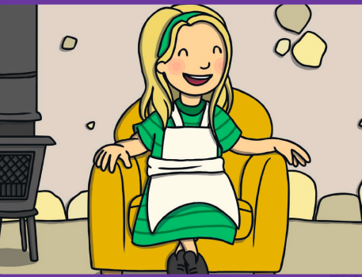
Today we are going to write a character description about Goldilocks.
1. Before you we start writing, let’s about what Goldilocks looks like?
Goldilocks has long blonde hair.
Goldilocks has a green hair band.
Share some more descriptions about Goldilocks’s appearance.

Slide 3
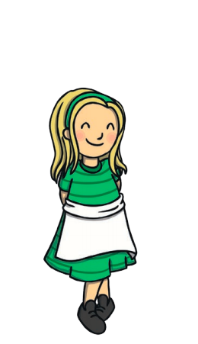
Now we are going to talk about what Goldilocks is like (her personality).
Goldilocks is naughty because she enters a stranger’s house and steals their breakfast.
Goldilocks likes to sleep in a comfortable bed.
Share some more sentences about Goldilocks’s personality.

Slide 4
Now you can use this sheet to write about Goldilocks. This is called a character description.

Slide 5
3. Now, you are going to write some sentences about Goldilocks. We call this a character description.
Task: First, write about Goldilocks’s appearance and then about how she behaves.
Next, choose one of the challenges below.
 | Challenge 1: Can you write a short sentence about Goldilocks’s appearance and how she behaves?
 | Challenge 2: Can you write a short paragraph about Goldilocks’s appearance and another short paragraph about how she behaves?
 | Challenge 3: Can you read your work and pick out any spelling mistakes? Can you check that your punctuation is correct?

Slide 6
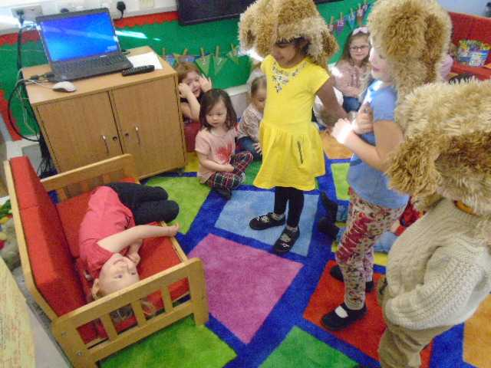
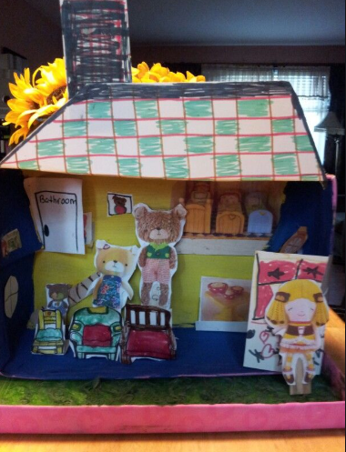
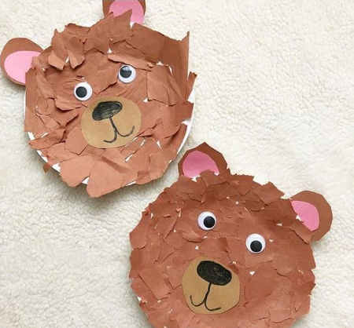
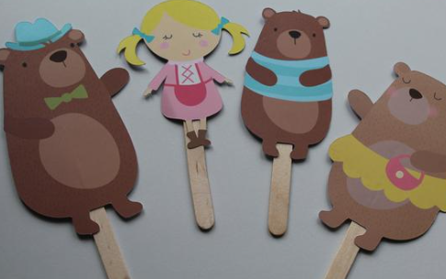
Remember to keep re-telling the story to your family and maybe act it out together!
Other Suggested Activities:
Make porridge and write instructions
Create lollipop stick characters
Make a story box of the story using an empty box
Make character masks using paper plates

