Slide 1
Year 1 – English – Lesson 4
Goldilocks

Slide 2
We are going to write the story of Goldilocks and the Three Bears.
1. I hope you pretended to be Daddy Bear yesterday. Did you think of any questions for Baby Bear? Before we start today’s lesson, practise reading and spelling our story words.

Slide 3
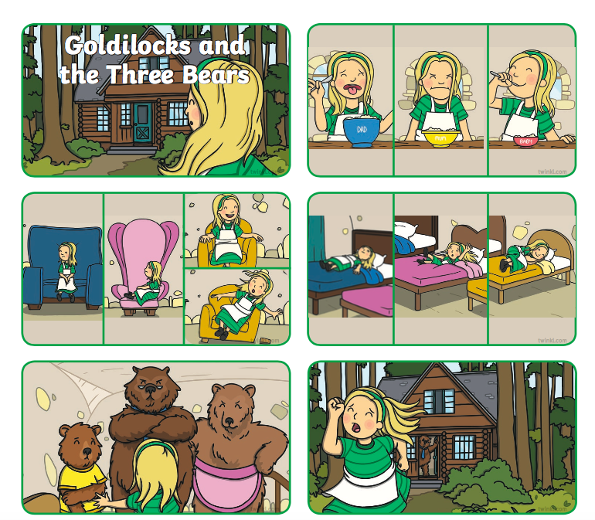
2. Today we are going to write the story of Goldilocks and the Three Bears. Let’s remember the order of the story. Re-tell the story to your adult.
Remember to use your story mat to help you with your vocabulary.

Slide 4
3. How will we start the story?
Which one will you choose?
Once upon a time
One sunny day
Early one morning
Please use these pictures to help you write your story.
How to use the picture prompts:
Look at each picture, one at a time, to help you retell the story. How many sentences can you write for each picture?
Use the sentence starters to help you.

Slide 5
Write your story on the worksheet called Part 1.

Slide 6
4. Now, you can write the story of Goldilocks and the Three Bears.
Task: Use the story mat and the picture prompts to help you write the story.
Next, choose one of the challenges below.
 | Challenge 1: Use the pictures to help you write your sentences.
 | Challenge 2: Check your story mat to use the story words and check your spellings.
 | Challenge 3: Write at least two sentences for each picture clue.

Slide 7
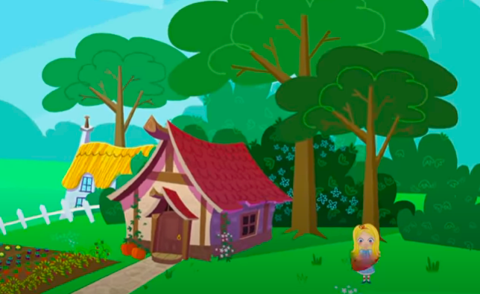
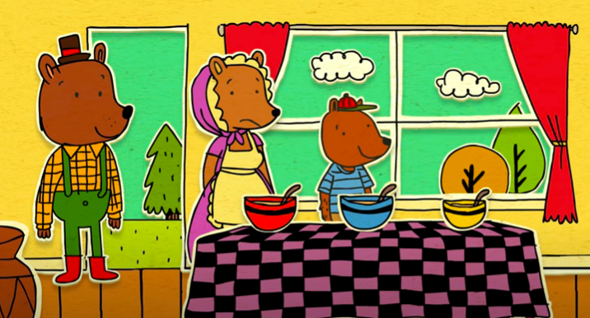
5. You can read different versions of Goldilocks and the Three Bears. Here’s some examples:
Watch the story..
https://www.youtube.com/watch?v=qOJ_A5tgBKM
https://www.youtube.com/watch?v=4JUk4umsUNw

