Slide 1
Year 6 Maths Week 11 Lesson 2
Statistics – Read and Interpret Line Graphs

Slide 2
Statistics – Read and Interpret Line Graphs
In this lesson you will apply yesterday’s learning to:
reasoning questions;
word problems.

Slide 5
Reasoning Question 1
Michaela is recording the amount of juice in 2 cartons throughout the week.
Which graph most likely shows her data?
Explain how you know.
A
B

Slide 6
Reasoning Question 1
Michaela is recording the amount of juice in 2 cartons throughout the week.
Which graph most likely shows her data?
Explain how you know.
B most likely shows her data because...
A
B

Slide 7
Reasoning Question 1
Michaela is recording the amount of juice in 2 cartons throughout the week.
Which graph most likely shows her data?
Explain how you know.
B most likely shows her data because it shows the amount in each carton decreasing over time as the contents are drunk.
A
B
© Classroom Secrets Limited 2018

Slide 8
Reasoning Question 2
Noel and Mei are interpreting this graph. Noel says, “The flowers are exactly the same height in September.”
Mei says, “The flowers were the same height in June, but then Flower 2 grew slightly taller than Flower 1.”
Who is correct? Explain.

Slide 9
Reasoning Question 2
Noel and Mei are interpreting this graph. Noel says, “The flowers are exactly the same height in September.”
Mei says, “The flowers were the same height in June, but then Flower 2 grew slightly taller than Flower 1.”
Who is correct? Explain.
Mei is correct because...

Slide 10
Reasoning Question 2
Noel and Mei are interpreting this graph. Noel says, “The flowers are exactly the same height in September.”
Mei says, “The flowers were the same height in June, but then Flower 2 grew slightly taller than Flower 1.”
Who is correct? Explain.
Mei is correct because in June, both flowers are 4ft in height and in July, Flower 2 is about 1ft taller than Flower 1.

Slide 11
Problem Solving 1
Henri and Georgia are choosing a site to go camping.
Which site is the warmest throughout the night?
They each need extra warm socks for any temperatures under 6˚C, and a hot water bottle each for any temperatures under 4˚C. What extra supplies will they need for each site?

Slide 12
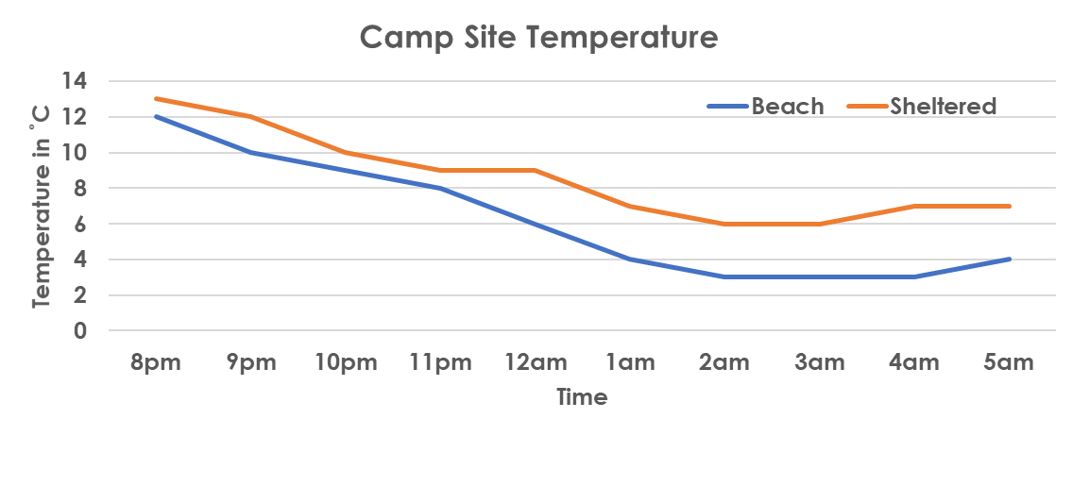
Problem Solving 1
Henri and Georgia are choosing a site to go camping.
Which site is the warmest throughout the night?
The sheltered site is warmer throughout the night.
They each need extra warm socks for any temperatures under 6˚C, and a hot water bottle each for any temperatures under 4˚C. What extra supplies will they need for each site?
On the beach, they will each need one pair of socks and one hot water bottle. On the sheltered campsite, they won’t need any extra supplies

Slide 13
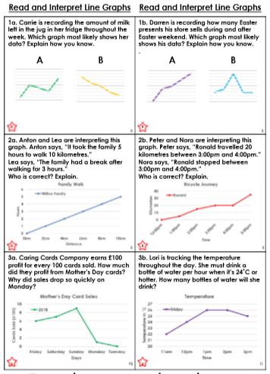
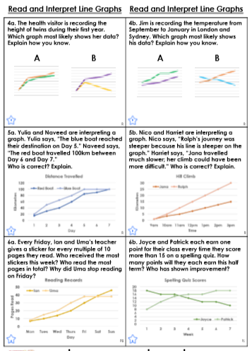
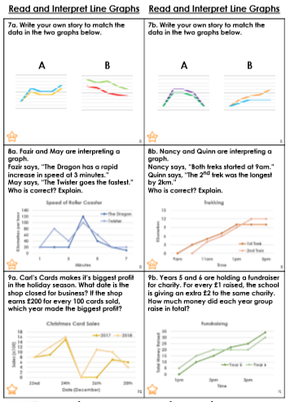
Task
Now have a go at one of the work sheets. There are three levels of accessibility. Pick a level. You may want to start on one level and build up to another level.
Developing
Expected
Greater Depth
Creative Task
On the next slide is a creative extension task.

Slide 14
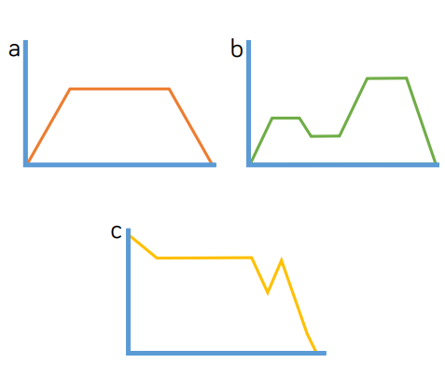
Task
Write a story for these three line graphs.
Possible contexts for each story:
A car speeding up, travelling at a constant speed, then slowing down.
b) The height above sea level a person is at during a walk.
c) Temperature in an oven when you are cooking
something.

