Slide 1
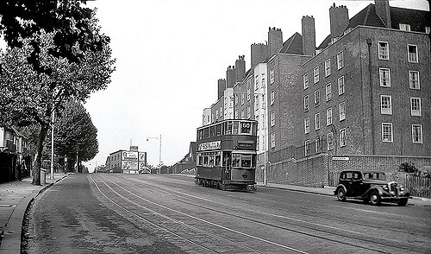
Topic Web - Year 3 – Autumn 1 - 2020
English
To re-tell a story based on Princess Smartypants
To understand different vocabulary
To write from different points of view (adverts)
To form arguments for and against
To write a character description
To form a paragraph
To explore a character’s behaviour and actions
To identify commas in lists
To use synonyms for said.
PE
PE with Mr Miller every Thursday.
PE with class teacher Beech Class: Tuesday
PE with class teacher Eucalyptus Class: Monday
Maths
We are following the Maths Mastery scheme.
Count forwards and back in multiples of 2, 3, 5 and 10 up to the 12th multiple; begin to count forward and back in multiples of 4 up to the 12th multiple.
Recall and use multiplication and division facts for the 2, 3, 5 and 10 times tables up to the 12th multiple
Recall and use addition and subtraction facts to 20 fluently (from Y2 programme of study)
Derive and use addition and subtraction facts for multiples of 10 to 100 e.g. 40 + 60 = 100, 100 – 70 = 30
Count on and back in 10s from any one- digit or two- digit number within 200 (refer to the 200 grid)
Read and write numbers up to 200 in numerals and words
Mentally add and subtract a 3-digit number and ones or tens up to and including 200 e.g. 126 + 8; 154 – 30
PSHE / R.E
Mind UP!
RE – How do Jews celebrate?
RE – Signs, Symbols and Sayings.
Computing
To use Scratch to programme and create games.
Use the internet to research our local area.
Geography
Use geographical vocabulary to ask and respond to questions.
Use primary and secondary sources of information.
Use and interpret maps.
Undertake simple mapping tasks.
Follow and to describe a route.
Recognise and describe some of the physical and human features of the local area.
Learn about the social and environmental changes in our local area
Location
Location
Our Location!!
Science
(Animals including humans – Skeleton, muscles and movement)
To recognise that humans have skeletons.
To introduce some of the main bones in our bodies.
To identify some of the important joints.
To identify some of our muscle systems.
To look at how muscles contract and expand.
To understand that some animals have skeletons on the outside called exoskeletons.
Art and Design
Looking at art in the local area.
Recreating art from our local area.
Create collage work from natural materials from the local area.
Sketching skills
Learning at home
Weekly times tables
Maths with Parents
Weekly spellings
Daily reading at home.
Home- School topic projects

