Slide 1
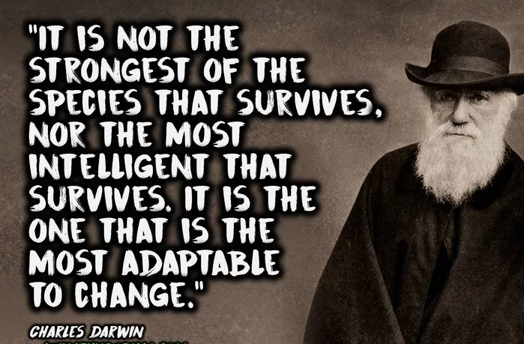
Planning Grid – Year 6 – Autumn 1 2020
PSHCE
New beginnings – have opportunities to appreciate similarities and differences between each other.
Build on their capacity for empathy and awareness.
Mindfulness: Children will be learning about mindfulness and positive higher-level thinking.
Literacy
The children will be learning how to write an autobiography. They will be writing listographies and chapters of their life. There will be a strong grammar focus on subordinating conjunctions, single and multi-clause sentences and using active and passive tense. This will the progress onto writing a biographical recount of Harriet Tubman.
Shared reading will be based around our history and science topics focusing on information retrieval, inference and deduction.
Numeracy
Following Southwark/White Rose planning
Children will be working their way through all the key skills in mathematics starting with place value, number facts and calculation, followed by shape and space and then moving through to measurement.
Daily mental maths, consolidating times tables facts and calculation work will take place in addition to the numeracy lesson.
PE
Class teachers will teach a PE lesson and the focus for this half term will be learning how to play Tag- Rugby.
PE with Mr Miller every Tuesday, where he will teaching the skills of football.
Art and Design/RE
The children will be learning how to paint landscapes with a focus on perspective.
For RE, the children will write about different art forms used in Christianity to express beliefs about God and explain how this is similar or different to another religion. They will comment on the symbolic importance of colours and music, with specific examples
Spanish
Children will learn about basic concepts and articles and songs about the world.
Round and Round
History
Historical figures
Year 6 will be learning about a significant world historical figure- Harriet Tubman which links in with our Literacy unit. The children will be focusing on the impact she had on the underground system.
Alongside learning about Harriet Tubman, the children will be investigating the slave trade and slavery in the USA.
Science
(Evolution and Inheritance)
Recognise that living things have changed over time and that fossils provide information about living things that inhabited the Earth millions of years ago
Recognise that living things produce offspring of the same kind, but normally offspring vary and are not identical to their parents
Identify how animals and plants are adapted to suit their environment in different ways and that adaptation may lead to evolution.
ICT
Children will learn to understand computer networks including the internet.
They will use logical reasoning to explain simple algorithms.
Design their own apps.
Use search technologies effectively to research and explore the wonderful technological world we live in!

