Slide 1

Grove Primary
Year 6 SATs 2026 Presentation for Parents, Carers & Guardians

Slide 2
SATs Timetable
Mon 11th May | Tues 12th May | Wed 15th May | Thurs 16th May
Breakfast Club 8 – 8.30am
SPaG | Reading | Maths 1 | Maths 3
Spelling |  | Maths 2 | (Friday – party)
Notes:
Write down different ways to express yourself.

Slide 3
Monday 11th May - SPAG papers
SPAG paper = 45 mins
One paper testing grammar, punctuation
and some spelling/vocabulary.
Spelling paper = 30 mins
spelling test- 20 words
Words given within context of a sentence and then repeated twice.

Slide 4
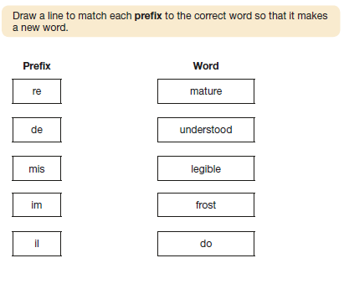
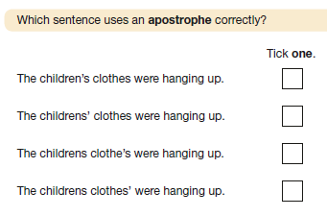
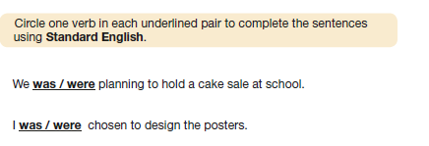
Examples of questions: SPAG Paper 1

Slide 5
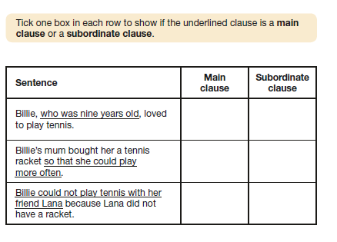
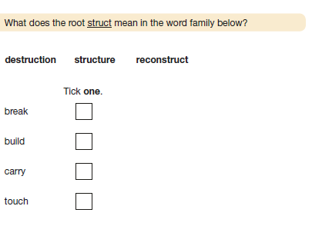
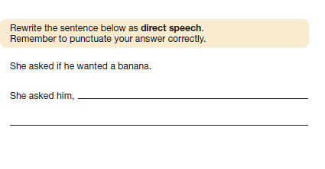

Slide 6
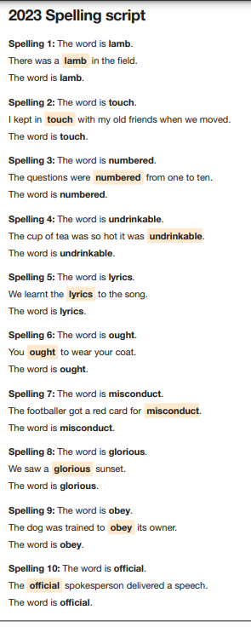
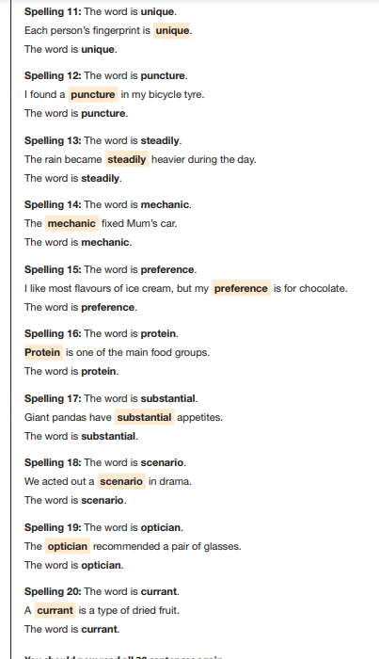
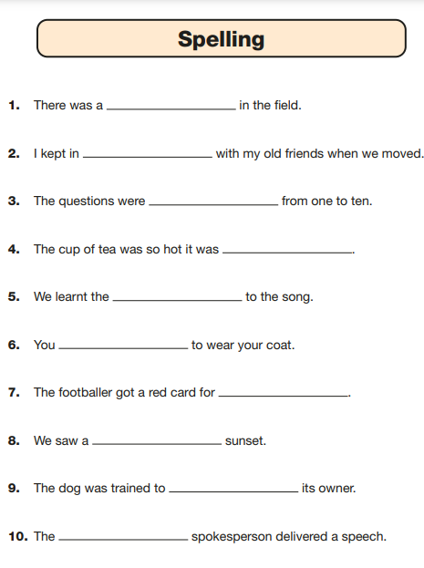
Examples of questions: SPAG Paper 2

Slide 7
Tuesday 12th May - Reading paper
3 text extracts = 1 hour
Extracts could be: poetry, range of fiction and non-fiction each text immediately followed by questions
Testing:
Retrieve information – fetch!
Deduce – work it out like a detective
Infer – ‘read between the lines’, show deep understanding
Summarise – identify main events, themes and sum up
Predict – what might happen next, how do you know?
Compare – what do the texts have in common/what’s different? Text types, effects etc.

Slide 8
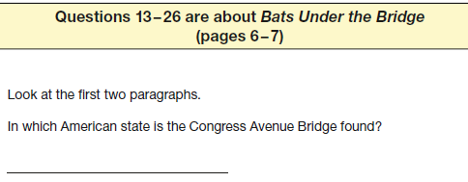
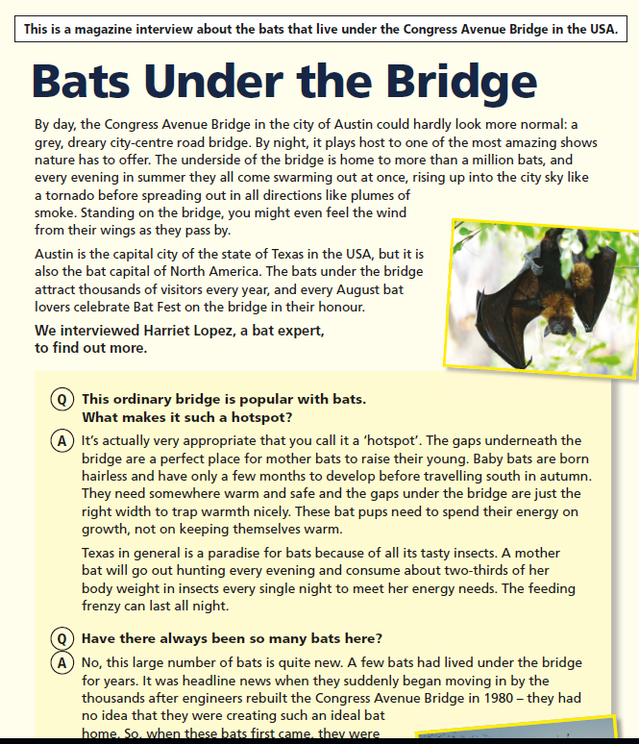
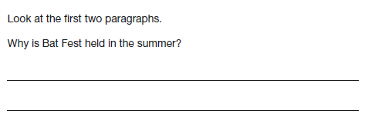

Examples of questions in Reading Paper

Slide 9
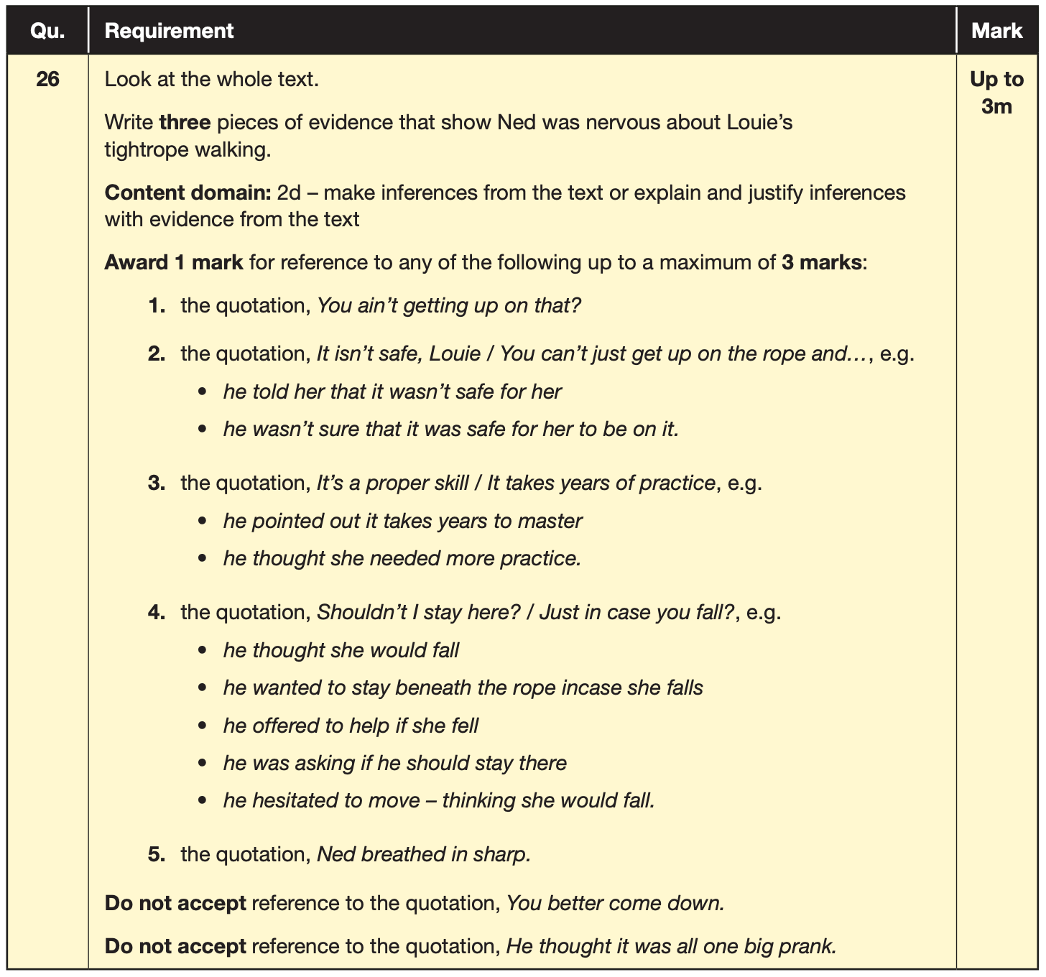
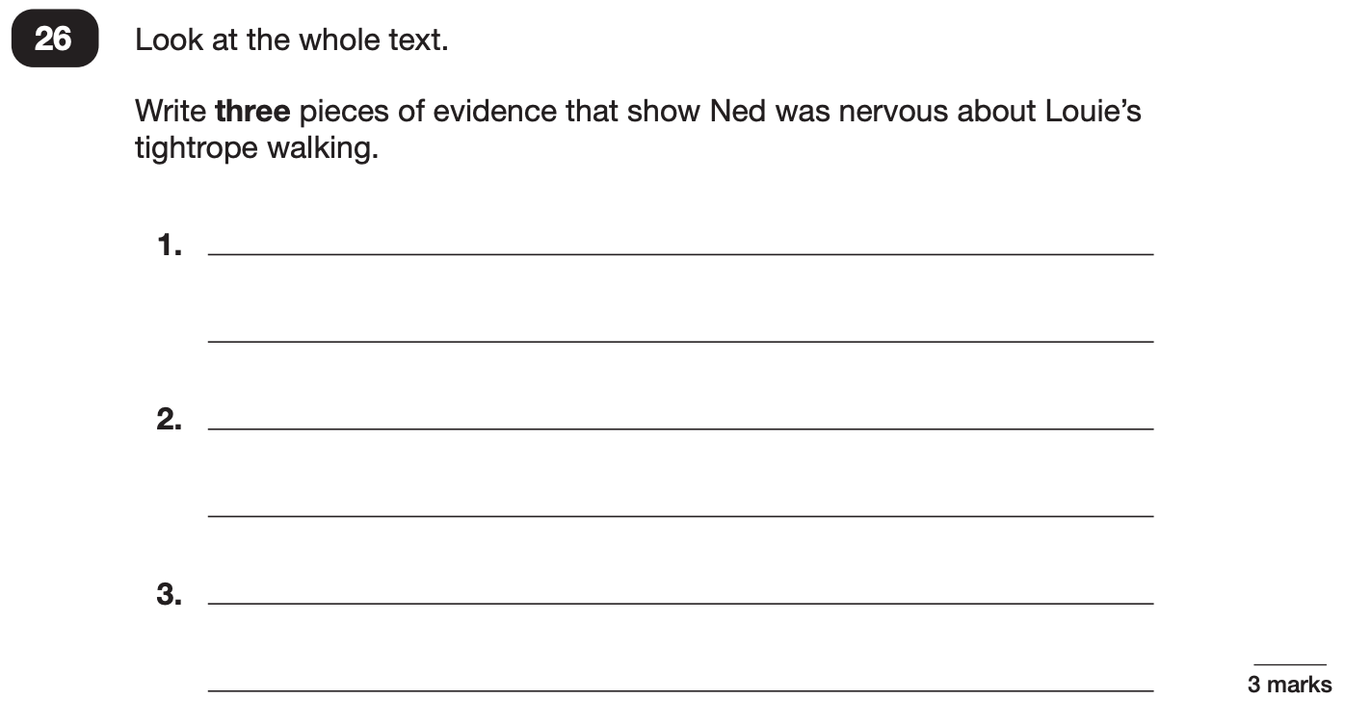
Reading
Example questions:
3 mark question
Notes:
Questions are from the 2024 Reading SATs paper.

Slide 10
Wednesday 13th May - Maths papers
Arithmetic Test = 30 mins
Calculating using all 4 operations, place value, Fractions/Decimals/Percentages.
Reasoning 2 and Reasoning 3 = 40 minutes each
Both test children on ability to apply their knowledge and skills
All areas of maths: including shape and space, statistics, measures, number.

Slide 11
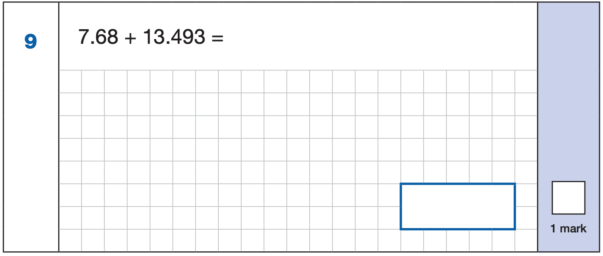
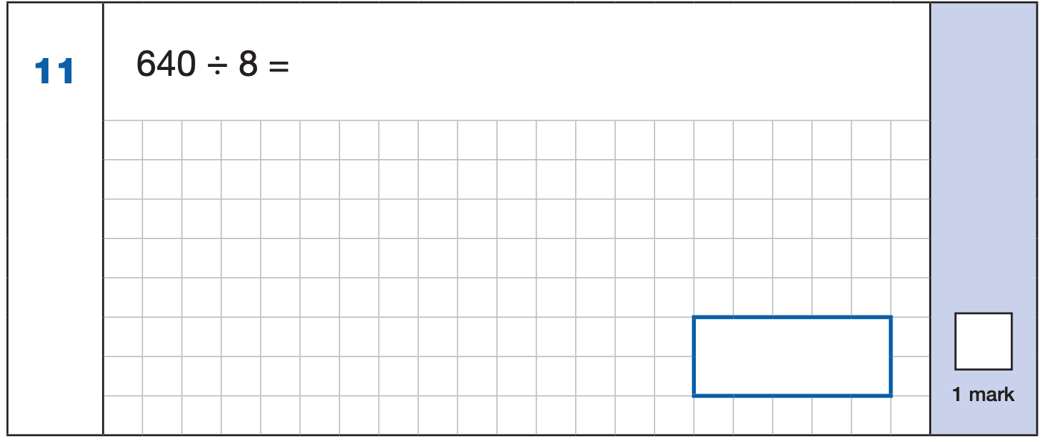
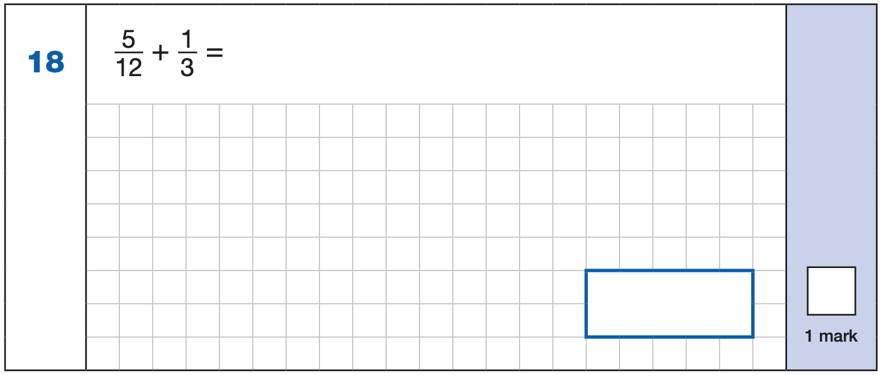
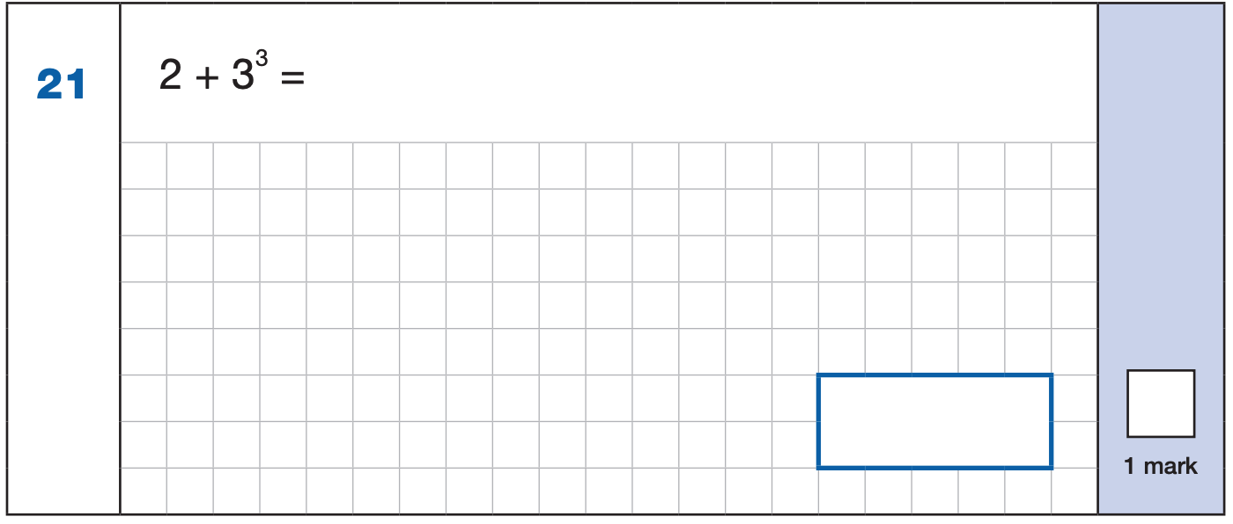


Maths Paper 1 (Arithmetic)
Example 1 mark questions:
7.680
+ 13.493.
21.173
¹ ¹ ¹
Mental method:
Using known fact of 64 ÷ 8 = 8
21.173
80
$\frac{\text{1}}{\text{3}}$ = $\frac{\text{4}}{\text{12}}$
$\frac{\text{5}}{\text{12}}$ + $\frac{\text{4}}{\text{12}}$ = $\frac{\text{9}}{\text{1}\text{2}}$
3³ = 27
2 + 27 = 29
$$\frac{\text{9}}{\text{1}\text{2}}$$
29
Notes:
Questions are from the 2024 Arithmetic SATs paper.
These are examples of how children could solve the calculations. There are some that could/ should be solved mentally as it is far quicker that way (40 marks in 30 minutes does not allow for 1 minute + per mark).
Answers should always be given in their simplest form unless stated otherwise.
Note that for question 18, equivalent fractions e.g. ¾ are accepted.

Slide 12
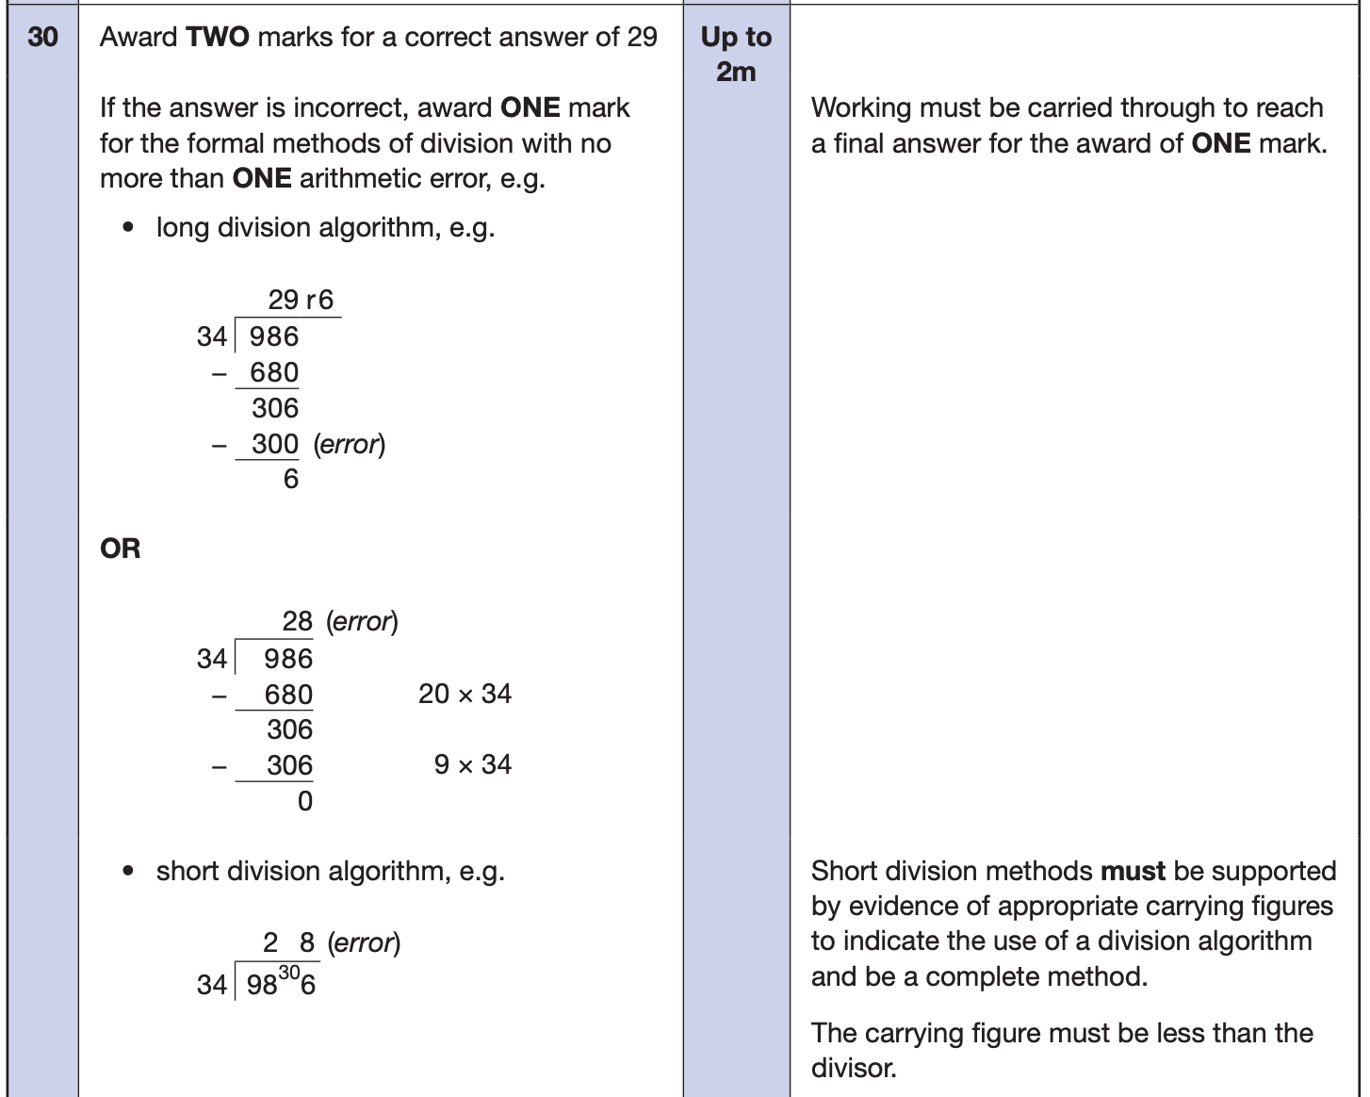
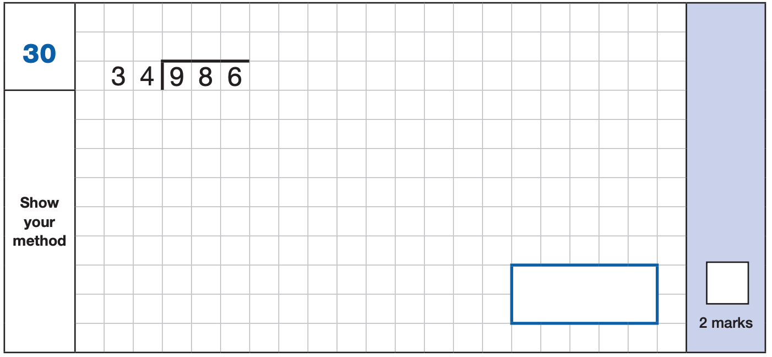
Maths Paper 1 (Arithmetic)
Example 2 mark question:
Notes:
Questions are from the 2024 Arithmetic SATs paper.

Slide 13
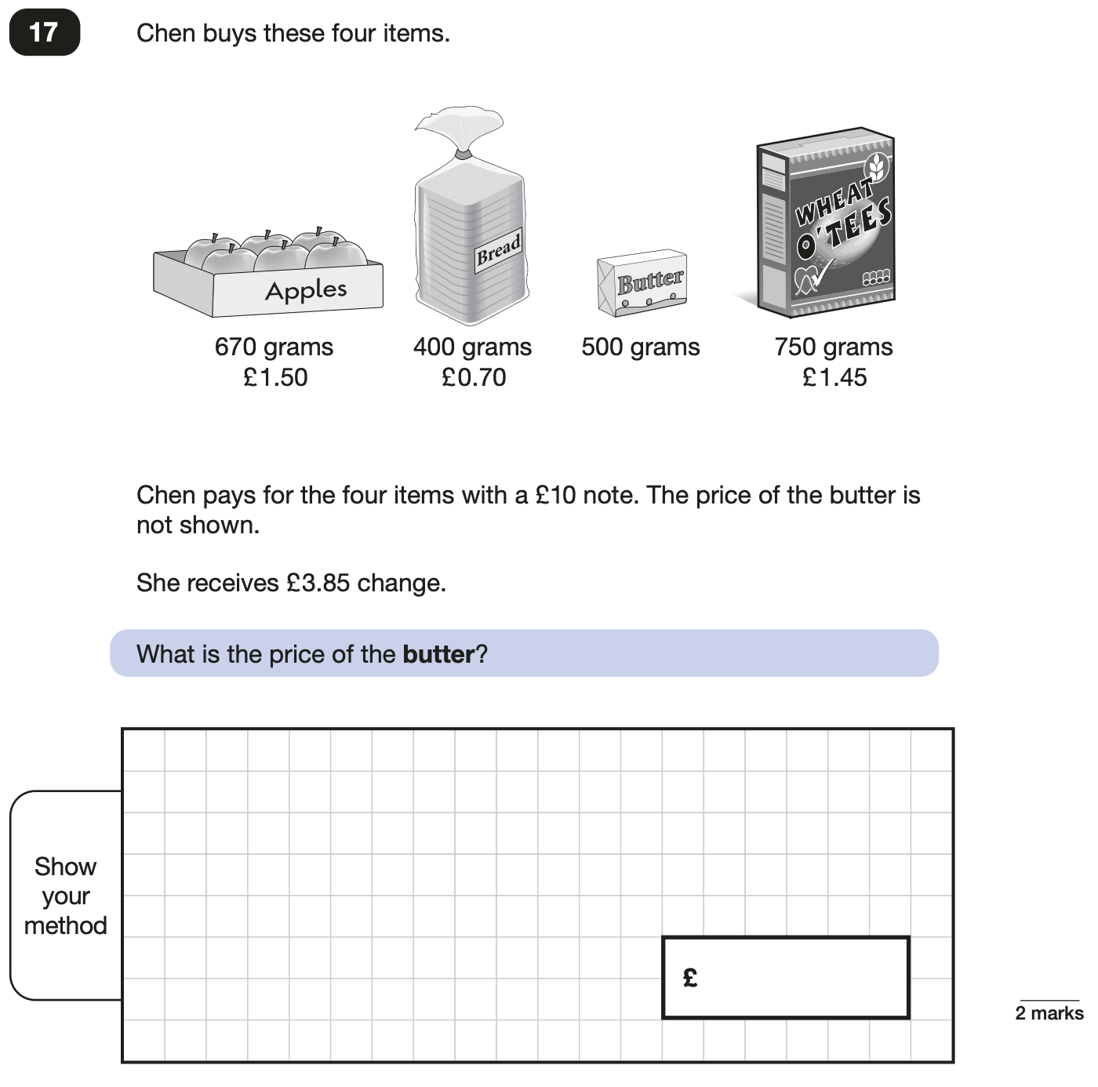
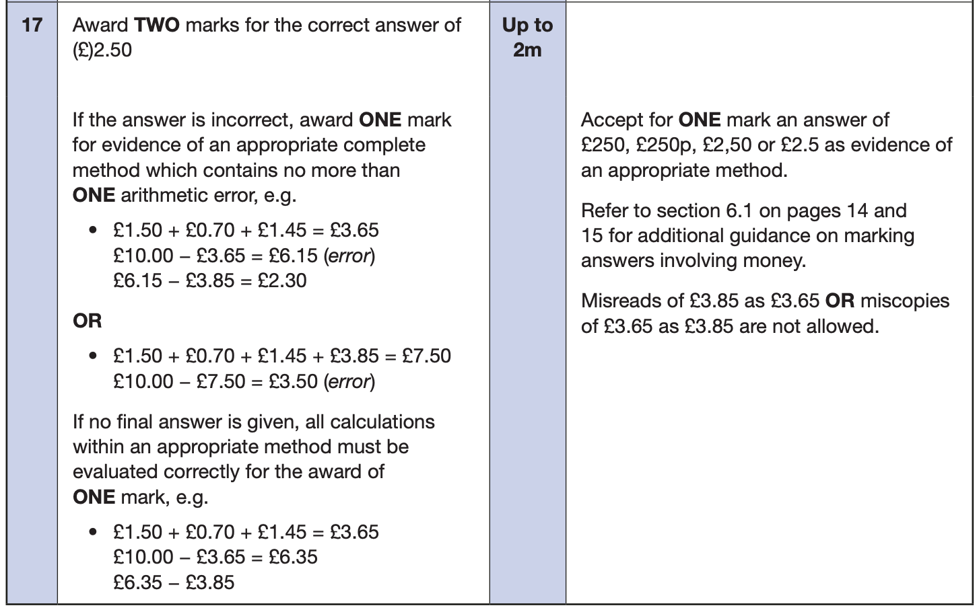
Maths Papers 2 (Reasoning)
Example questions:
Notes:
Questions are from the 2024 paper 2 Reasoning SATs paper.

Slide 14
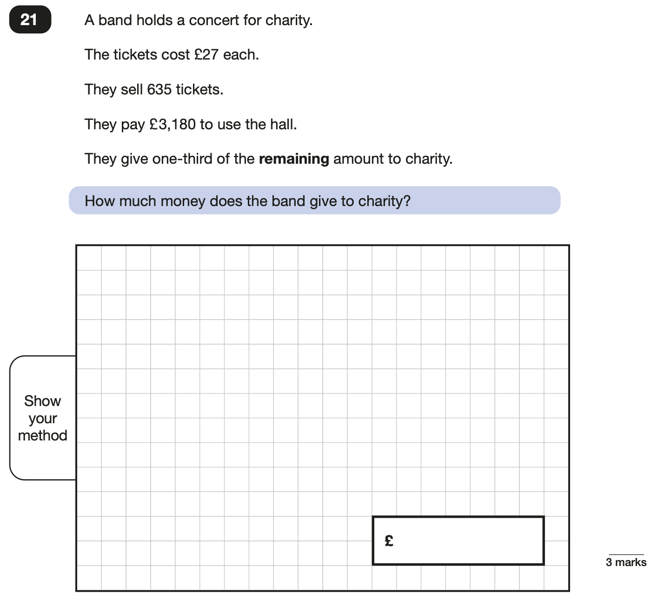
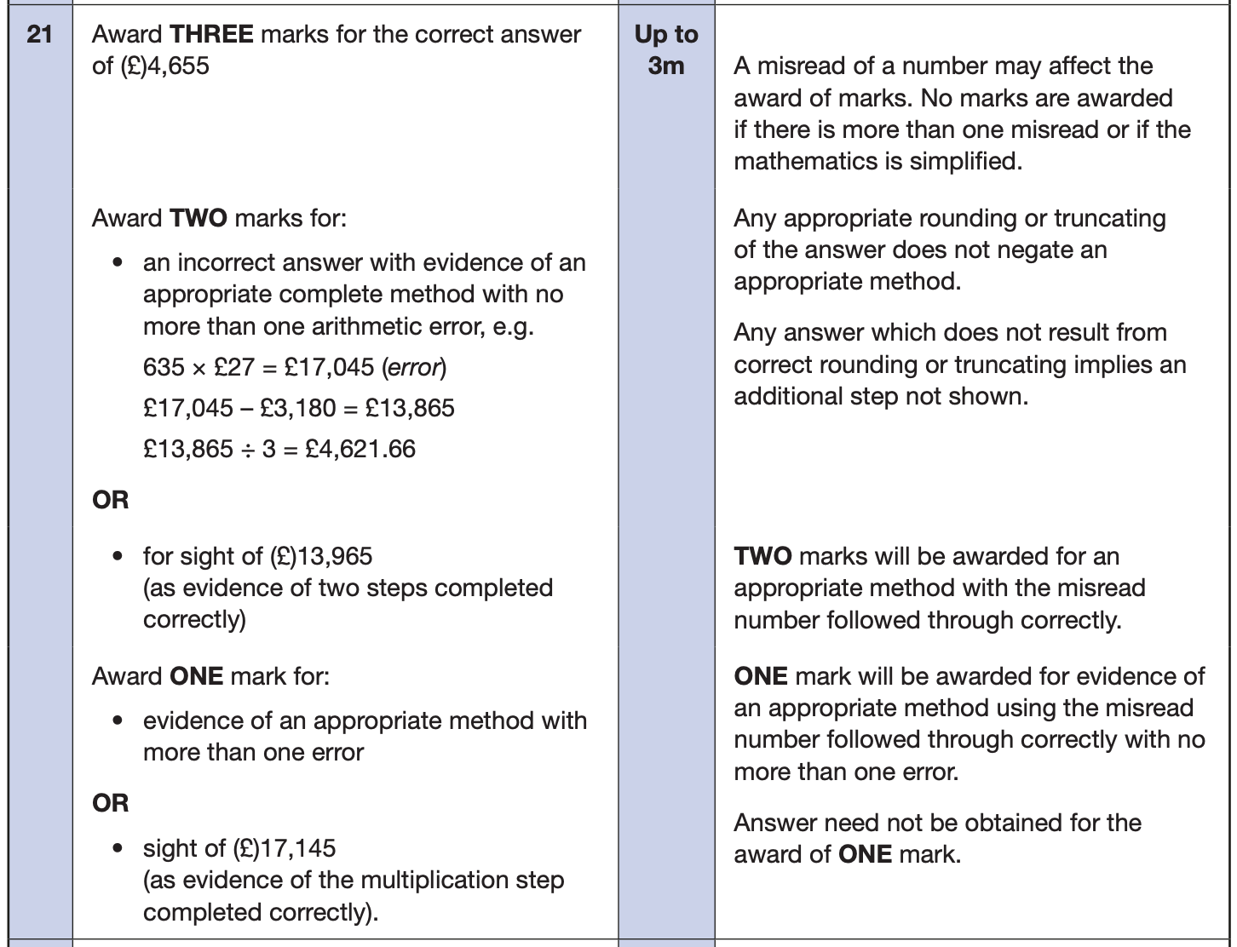
Maths Papers 3 (Reasoning)
Example question:
Notes:
Questions are from the 2024 paper 3 Reasoning SATs paper.
Note that this is a three mark question.

Slide 15
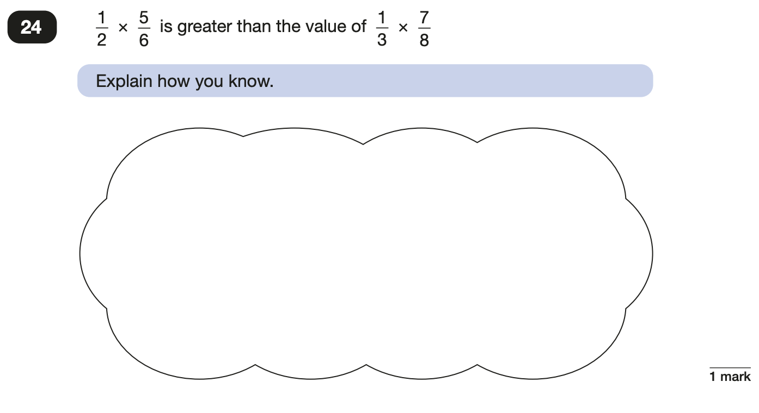
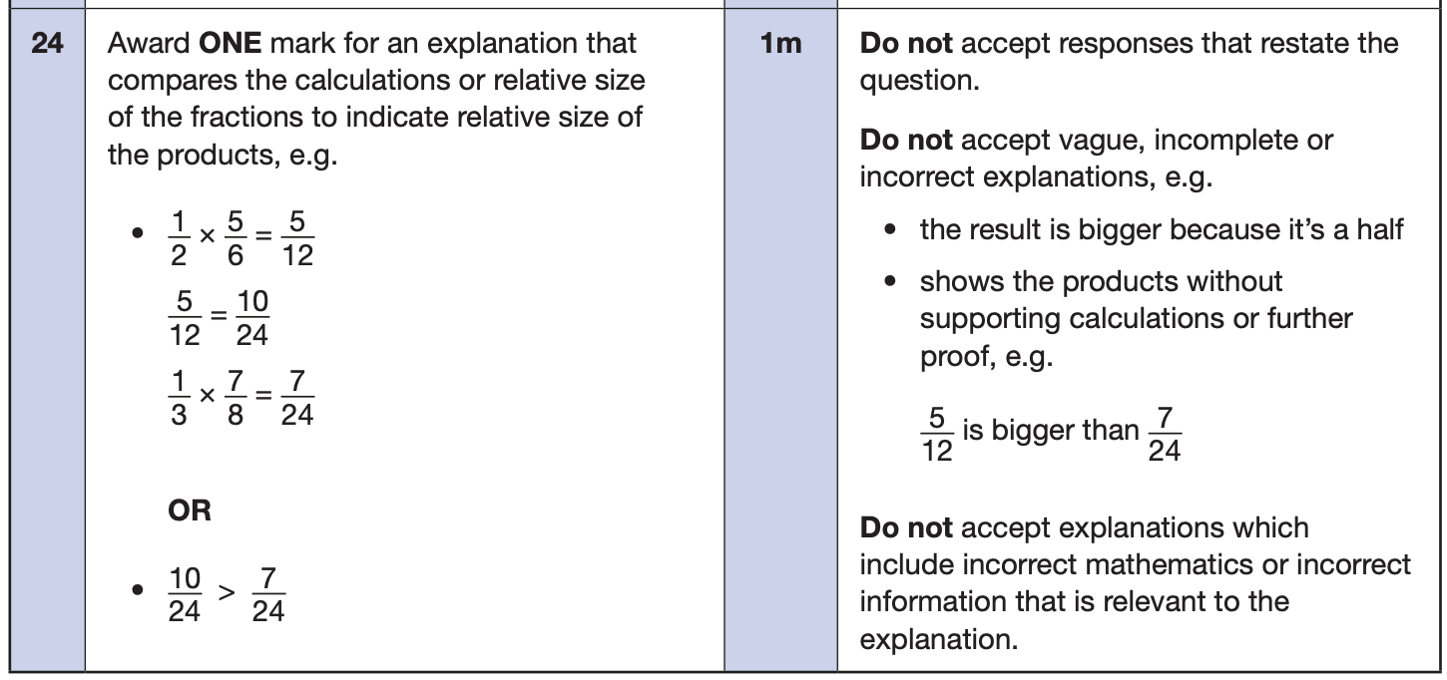
Maths Papers 3 (Reasoning)
Example questions:
Notes:
Questions are from the 2024 paper 3 Reasoning SATs paper.

Slide 16
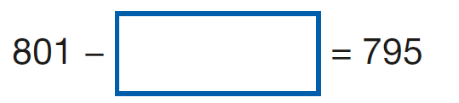

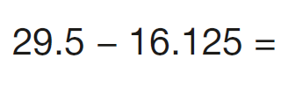
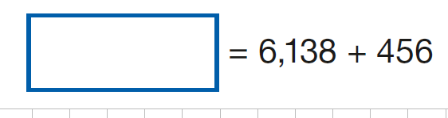
Quick wins
Fractions – use times tables to find the common denominator
X or ÷ 10,100,1000,10000,1000000 – place value – use the number of 0’s
Times tables – learn these fluently
0.25 is the same as ¼ or 25%, 0.50 = ½ = 50%, 0.75 = ¾ = 75%
Use the inverse for missing number questions
Make sure that the 0s are placed on the decimal in order to + or - and the decimal point is aligned.
Don’t get muddled with easier questions that are laid out like this…
7.800 +
6.953
29.500 -
16.125

Slide 17
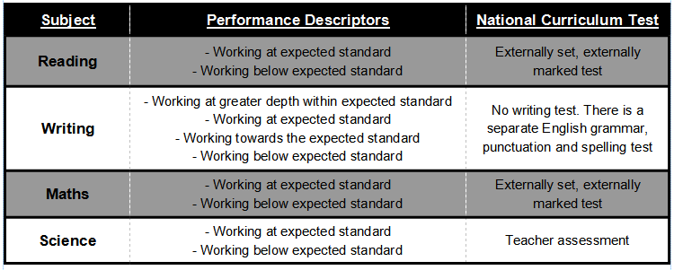
Teacher Assessment

Slide 18
Practicalities - results
Results of any national curriculum tests taken, will be reported to you with your child’s end of year school report
Tests are marked externally. Once marked, the tests will be given the following scores:
A raw score (total number of marks achieved for each paper);
A scaled score (see below);
A judgement on if the National Standard has been met.
After marking each test, the external marker will convert the raw score to a scaled score. Even though the tests are made to the same standard each year, the questions must be different. This means the difficulty of the tests may vary. Scaled scores ensures an accurate comparison of performance over time.
Scaled scores range from 80 to 120.
A scaled score of 100 or more shows the pupil is meeting the National Standard.

Slide 19
Things to remember about SATs
SATs focus on what children know about Maths and English.
They will not reflect how talented they are at science, geography, art, PE…, and they certainly won’t highlight all their amazing personal characteristics.
SATs don’t tell the whole story.
Their results will say if they did or did not meet a certain standard but not necessarily by what margin. These thresholds change each year according to the overall national performance, so what was classed as ‘meeting the expected standard’ this year might not be the same as last year. Your school may be able to provide you with more detailed feedback.
SATs are only four days out of a whole Primary School career.
In reality, there's one or two papers each day that last 30 to 60 minutes.

