Slide 1
Year 5
Parent Curriculum Meeting
Date: 9th September 2021

Slide 2
Aims:
Opportunity to meet your child’s class teacher
Opportunity to hear about what your child will be learning and how you can be involved

Slide 3
Year 5 Team
Hazel Class Teacher: Miss Reid
Teaching Assistant:
Mrs Harsanyova

Slide 4
Our Vision
Within the River Hill Federation, we aspire to create a supportive environment for personal growth and where enquiring minds develop a passion for learning.

Slide 5
Our Values
Creativity
Ambition
Resilience
Empathy
Respect
Courage
“Respect, Ready, Safe”

Slide 6
School Day
We are excited to welcome parents and carers back into the school playground. However, we are conscious that this pandemic is not over and we want to keep our school community as safe as possible.
Therefore we have put the following measures in place to allow children and their parents / carers to enter and exit the premises as safely as possible. We encourage parents and carers to drop off and collect children promptly, leaving the school grounds quickly to reduce congestion.
Drop off arrangements:
The large car park gates on Dog Kennel Hill Road will open at 8:45am. Children and parents/carers should enter through these gates.
Children in years 1-4 will proceed directly to their classrooms.
Children in years 5-6 will line up where indicated in the main playground. The class teacher will take children to class at 8:55am.
Parents/carers should exit the premises via the single gate on Dog Kennel Hill Road.
Please note that children who arrive after 9:00am should enter via the school office and will be marked as late.
Collection arrangements:
Parents/carers should enter the school via the single gate on Dog Kennel Hill Road.
Parents/carers are asked to collect their children and promptly leave the school premises via the large car park gates on Dog Kennel Hill Road.

Slide 7
Play Time / Lunch Time
Government guidance no longer requires children to stay in bubbles.
Children in years 1-4 will have lunch at 11:30-12:30
Children in years 5-6 will have lunch at 12:30 – 1:30
Playtimes have been arranged so that the number of children accessing the playground at one time is reduced, with a maximum of 6 classes using the playground at any one time.

Slide 8
Updated Covid Guidelines for Schools
Parents / carers are asked to engage in the NHS Test and Trace process, if required to do so, and follow directions from Public Health.
When will children need to self-isolate?
Children must self-isolate straight away and get a PCR test (a test that is sent to the lab) on GOV.UK as soon as possible if they any of these 3 symptoms of COVID-19, even if they are mild:
a high temperature
a new, continuous cough
a loss or change to your sense of smell or taste
Children should self-isolate straight away if:
They have tested positive for COVID-19 or
If they have been told to self-isolate by the NHS Test and Trace Process
Please note, children under 18 years, 6 months do NOT need to self-isolate if someone they live with has symptoms of COVID-19, or has tested positive for COVID-19
Instead, they will be contacted by NHS Test and Trace, informed they have been in close contact with a positive case and advised to take a PCR test. We would encourage all individuals to take a PCR test if advised to do so.
The school’s updated risk assessment is on the website and provides detailed information of how the school is following DfE guidelines to reduce the spread of the virus and to protect children and staff .

Slide 9
Homework
Children have been given homework books in order to support them with their learning. Homework will be given out every Friday and should be returned the following Thursday.
Homework is not compulsory but we would like to encourage children to complete homework tasks as it promotes independent learning skills and positively impacts on progress.
There is more support available for you on the school website.
Your support is greatly appreciated.

Slide 10
On-Line Learning
Your child will have access to Time Table Rock Stars.
Time Table Rock Stars will support your child in learning their times tables and associated division facts as well providing them with an opportunity to create their own avatar and earn certificates as they progress.

Slide 11
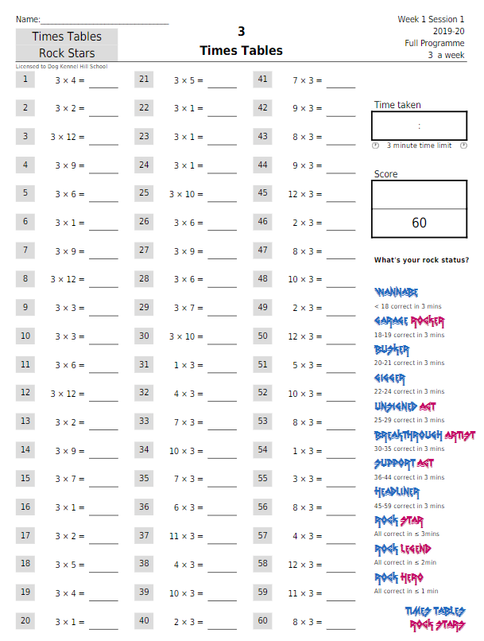

Slide 12
Additional Work
We would like to encourage children to complete additional daily work to help and support the children on their journey to Year 6.
CPG 6 Books for £11.00

Slide 13
Please Remember
Water Bottles: Every child must bring in a water bottle, clearly labelled with their name and class.
Shoes: If your child is not able to tie their own shoe laces, we ask that parents ensure they wear Velcro shoes.
Hair: Children’s hair that is longer than shoulder length must be tied up.
Bags: Children should bring their own school bags that can fit their personal belongings including jumpers and water bottles.

Slide 14
Home - School Agreement Parent / Carer:
To help my child at school, I will do my best to:
Make sure that my child attends school regularly and inform the school of the reasons for any absence
Support the school in maintaining good behaviour and discipline
Attend open evenings for parents. (Parent meetings will take place via Microsoft Teams for the Autumn Term.)
Ensure that my child dresses appropriately for school
Let the school know if there are any problems that may affect my child’s ability to learn.
Provide healthy lunch choices, if my child brings in their own lunch
Support my child with homework and other home learning opportunities and listen to my child read and read to them also (10 mins)
Make sure my child arrives in school on time and is collected on time
Strive to maintain a positive partnership with the school, even in difficult times.

Slide 15
Home - School Agreement Pupils:
I will do my best to:
Work hard and listen carefully to instructions
Come to school regularly and be on time
Keep to the school rules and behave well
Demonstrate the school values and be an ambassador for DKH
Do my homework regularly and bring it back to school
Dress appropriately for school
Bring my PE kit into school on days that I have PE lessons
Take good care of the school environment
Work hard to achieve my targets and aim to beat them
Do my best and work hard
Strive to follow the class moto of being ‘Respectful, Ready and Safe’

Slide 16
Home - School Agreement School:
Will do its best to:
Encourage your child to do his/ her best at all times
Expect the best from your child in behaviour and work
Inform parents and carers regularly how their child is progressing
Inform children, parents and carers what the teachers aim to teach your child each term
Take reasonable steps to ensure the safety, happiness and self-confidence of all your child
Be open and welcoming at all reasonable times and offer opportunities for parents and cares to become involved in the daily life of the school
Set, mark and monitor homework tasks regularly in keeping with the school’s policy
Contact parents and carers as soon as possible if we are concerned about your child’s learning, progress or behaviour
Contact parents and carers if there is a persistent problem concerning your child’s attendance or punctuality
Offer a broad and balanced curriculum which meets the needs of your child (the curriculum may be adjusted depending on DfE guidelines)
Provide healthy lunch options
Listen to your child’s ideas and encourage him/ her to speak out
Encourage your child to keep fit and active
Challenge your child and ensure that he/ she does his/ her best
Ensure your child understands the teacher and any curriculum covered
Maintain a professional and positive partnership with parents and carers, even in difficult times.

Slide 18
RSE
Relationships education is statutory in all primary schools in England. In line with government guidance.
We will continue delivering the Christopher Winter’s Programme. CWP's success is based on a thorough understanding of what constitutes effective teaching and learning for both teachers and pupils. They have been awarded the Award for Excellence in SRE.
Lessons are delivered in the Summer Term
The focus is on science and changes and an overview of all lessons is available on our website in addition to a video of FAQs.

Slide 19
Ways to Help
Encourage children to write regularly including: cards, lists, letters, stories, postcards, fact files. Celebrate clear, cursive handwriting.
Read with your child as often as you can and ask them questions so that they can interrogate the text. Encourage a love of reading!
Support your child with the weekly homework tasks.
Visit useful websites such as:
http://www.primaryresources.co.uk/
https://www.phonicsplay.co.uk/
http://www.ictgames.com/resources.html
Purchase workbooks from leading book stores such as: WHSmith, Waterstones etc. Use the local library.

Slide 20
PE Days
Hazel Class
PE will take place on Monday and Friday.
We are delighted to inform you that Mr Miller, our PE coach, has recovered from his knee surgery and will teach the PE session.

Slide 21
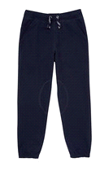
PE Uniform
Please make sure that your child is wearing the correct PE uniform. This includes:
Outdoor shoes must not be canvas to prevent ankle and foot injuries. AstroTurf football shoes are recommended for those that play football regularly as they are hard wearing, otherwise running shoes are the most comfortable and supportive
PE Lessons:
It is best that children bring both indoor and outdoor kit for all lessons just in case
we have to change the venue of the lesson because of the weather.
Outdoor PE kit
Indoor PE kit
Navy Blue
White T
Navy Blue
Plimsolls/
-
Shirt and
White T
-
Navy Blue
Jumper
running shoes or
Shirt
Shorts
(at the
gymnastic
Joggers
Astroturf football
length pictured)
shoe
/bare feet
shoes. No canvas
for dance and
style trainers.
gymnastics

Slide 22
High standards of behaviour:
The Governors strongly believe that high standards of behaviour lie at the heart of a successful school. Good teaching and learning promote good behaviour and good behaviour promotes effective learning. Children have the right to learn and to achieve their full potential in all aspects of their lives, and staff have the right to teach. Governors also believe that the expectation of high standards of behaviour which are required during the school day can have a positive effect on the life of young people outside school in encouraging them to become successful citizens.
We continue to use Zones of Regulation across the school as well as providing and encouraging the use of reflection boxes in each classroom. Children take part in regular brain breaks and mindfulness sessions.
The school has a behaviour policy which can be found on our school website.

Slide 23
No Bullying Allowed

Slide 25
After School Club and Breakfast Club
Tree Tops Clubs will be offering Breakfast Club and After School Club. All clubs are Ofsted registered and the staff team is carefully recruited following safer recruitment practices. Members of the team are DBS checked, trained in Safeguarding, First Aid, Health and Safety and Behaviour Management, Senior staff hold qualifications in childcare or playwork and regular supervision and CPD is carried out for all our staff.
Breakfast Club is available from 7:30am-9:00am
Afterschool Club is available from 3:00pm-6:00pm
Bookings can be made directly though their website.
http://www.treetopsclubs.co.uk/listing/dog-kennel-hill-primary-school/

Slide 26
Communication
At DKH we work hard to foster positive relationships with parents, carers and the wider community. We understand good communication will promote this. We will communicate with you via:
Weekly Newsletter sent via email
School Website: www.dkh.org.uk
Emails
As face-to-face contacts continue to be limited, your child’s class teacher will contact you via email. Please do use the email they provide to communicate with them.
They may also contact you via email if your child has had a minor injury during the school day. This will be supported by an injury slip. Significant injuries will continue to be communicated by telephone.
Contacting through the school office
Office Reception hours will be from 9:30am – 3:00pm and 3:30 – 4:00. Parents and visitors will not be accommodated in the office outside of these times as that will affect children’s start and leaving times. Please note that the last query before 3:00pm is at 2:50pm to allow staff to prepare for dismissal.
Visitors to the school are encouraged to wear a face covering.
Text messages (on occasions)

Slide 27
Who do I speak to?
Class Teacher (Teachers will attempt to respond within 3 days)
You should email the class teacher in the first instance, to discuss:
*How to support learning
*Social, academic, and personal progress
*Classroom and playtime incidents
*Organisational issues e.g. lost property which is not in the lost property area
Deputy or Assistant Head Teachers / Phase Leader:
KS1: Years 1, 2 speak to Jo McCoy
KS2: Years 3, 4, 5 and 6 speak to Thomas Newman
You can email or telephone to arrange an online appointment via the office to:
Discuss any ongoing concerns or unresolved issues in the first instance before speaking to the Head of School
Head of School:
You should contact Barbara Ghezzi
bghezzi@dkh.southwark.sch.uk to discuss:
*Unresolved issues after speaking to the class teacher and Deputy or Assistant Head Teachers
*Safeguarding issues
Executive Head:
You should contact Mrs Galiema Cloete
head@rotherhithe.southwark.sch.uk:
*Unresolved issues after speaking to the Head of School
*Safeguarding issues as mentioned above.
At Dog Kennel Hill, it is of paramount concern that all our children are happy and safe. If you have any concerns about the safety or wellbeing of a child, please email or telephone our Safeguarding and Intervention Officer, Shirley Nichols or a member of the Senior Leadership Team; Executive Head (Galiema Amien-Cloete), Head of School (Barbara Ghezzi) Deputy Head (Natalie Melehi) Assistant Head Teacher (Thomas Newman (YR 3,4,5&6)

Slide 28
Contact Details
Please complete an updated contact form which has been sent via email. It is important that we are able to get in contact with you in the case of an emergency.
Important Details Required:
Landline telephone number
Mobile number (for text messaging service)
Current address
Work number
Next of kin/emergency contact number & address
Email address (for email list)

Slide 29
Thank you!
We understand that this period of time has been difficult for our school community and that everyone has been impacted by the pandemic in different ways. We continue to be committed to provide you with clear communications and expectations but there may be times when we have to make changes and ask for your continued support.

