Slide 1
Year 1 Supporting Phonics at Home

Slide 2
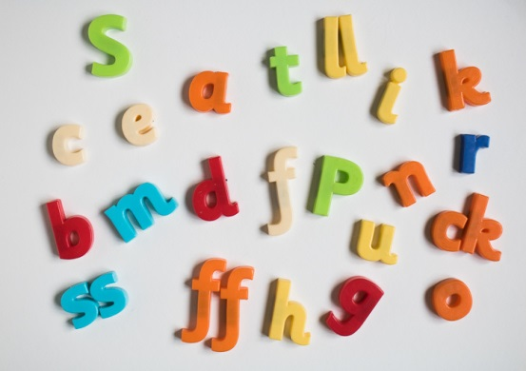
Today we are going to look at:
What is phonics?
How Phonics is taught at our school
The Phonics Screening Check
How you can support your child at home
Welcome

Slide 3
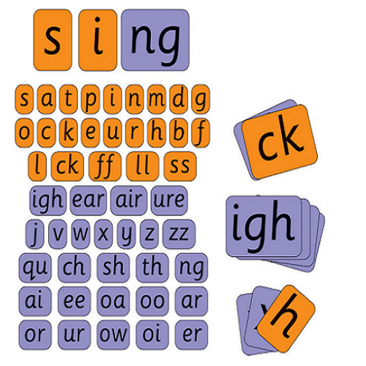
What is Phonics?
Phonics helps children develop good reading and spelling.
Children are taught to read by breaking down words into separate sounds or ‘phonemes’. They are then taught how to blend these sounds together to read the whole word.
Children learn to convert a letter or letters into sounds that are then blended together into a word
e.g. ch in chop ay in play

Slide 4
What is Phonics?
Although there are 26 letters of alphabet, these letters, and a combinations of these letters, make 44 sounds.
For example:
The letter a can make a soft a sound (flat) and a long a sound (make)
You can combine letters like oi and oy to make a new sound – boy spoil

Slide 5
How we teach Phonics
At DKH, we follow the DPiL programme. It covers all 44 sounds, which are taught across EYFS to Year 2. Children have a phonics lessons each day and they are encouraged to use these strategies to read and write in other lessons.

Slide 6
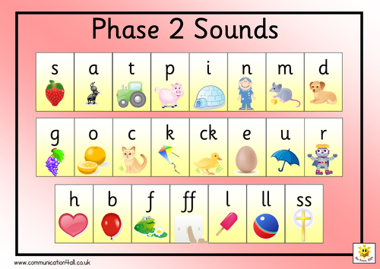
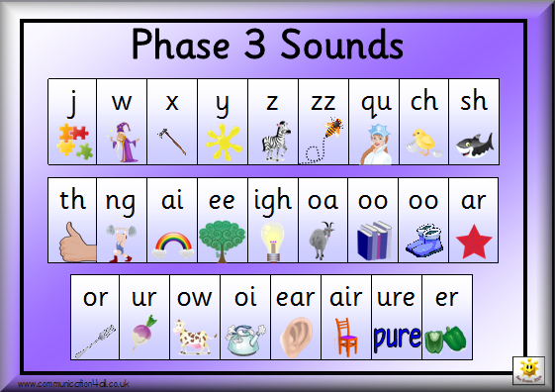
Throughout reception

Slide 7
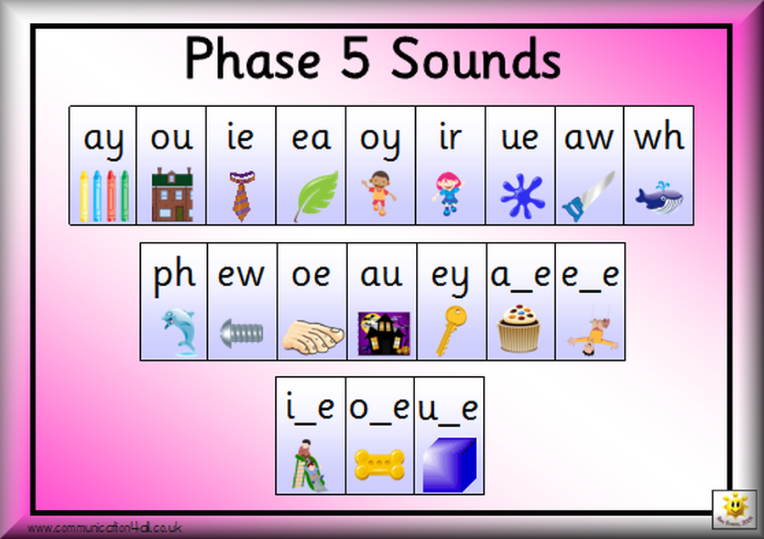
Year 1
Phase 4 and 5
Complex code, vowel sounds, alternative graphemes

Slide 8
Terminology
Phoneme – smallest unit of sound in a word.
How many phonemes can you hear in these words?
cat
mash
boat
light

Slide 9
Terminology
Phoneme – smallest unit of sound in a word.
We use sound buttons and lines to identify the phonemes.
cat
mash
boat
light

Slide 10
Terminology
Grapheme – The letter or letters representing a phoneme
cat
mash
boat
light
All the sounds with buttons are 1 letter graphemes
2 letter grapheme
3 letter grapheme

Slide 11
Terminology
Segmenting - recognising the letter sounds in a word
For example s-p-oo-n
The phonemes have been read

Slide 12
Terminology
Blending - stringing together sounds within a word
For example s-p-oo-n
The phonemes have been read and now they need to be merged in order to determine the word - spoon

Slide 13
To help blend and segment words, we use claps, our fingers, and stretching words to show each sound and letters.
spoon
play
slow
s
p
oo
n

Slide 14
Pronunciation of sounds
It is important that we use the correct pronunciation of sounds and we don’t add an ‘uh’ at the end.
‘sss’ not ‘suh’
Use this video to help you articulate each phoneme correctly.
https://www.youtube.com/watch?v=UCI2mu7URBc&list=PLB5TN0ac12P97k0x0Xvn8K46bw-vTTeUD&index=2&t=1s&app=desktop

Slide 15
Tricky words
These words don’t follow the phonics sound rules. Children will need to learn them by sight.

Slide 16
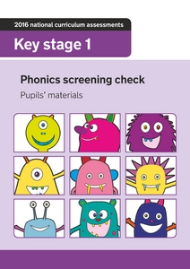
Phonics Screening Check
The phonics screening check is taken individually by all children in Year 1 in England, and is taken in June.
It is designed to give teachers and parents information on how the child is progressing in phonics.
It is not a formal test, children are made to feel relaxed and calm and can take breaks when they wish.
The class teacher will administered the check and results will be shared in the end of year report.

Slide 17
Phonics Screening Check
There are two sections in the 40-word check and it assesses phonics skills and knowledge learned through Reception and Year 1. Children will need to read real and alien (pseudo) words.
Alien words are phonetically decodable but not actual words. It’s to check if they can use their phonics knowledge and not just their memory.

Slide 18
Phonics Screening Check
REAL ALIEN
Notice how the sounds in the alien words are decodable.
The children should know these
to help read both real and alien words

Slide 19
How you can help your child at home
Listen to your child read as often as you can. They will receive a phonics reading book which will reinforce the phonics sounds they are learning in school. It is important to have opportunities to read for pleasure as well.
Read to your child.
Ask questions and share opinions on what they have read.
Use the phonics pack to decode words from the lists provided. They will need to identify real and alien (pseudo) words.
Use provided website/apps to support their reading.

Slide 20
How you can help your child at home

Slide 21
How you can help your child at home

Slide 22
We hope you’ve found the workshop useful!
Any Questions?
Please don’t forget to take your handouts and use the materials to support your child with their reading!

