Slide 1
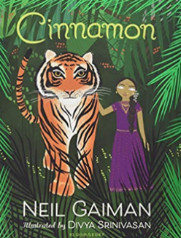
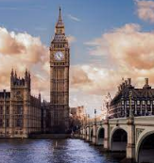
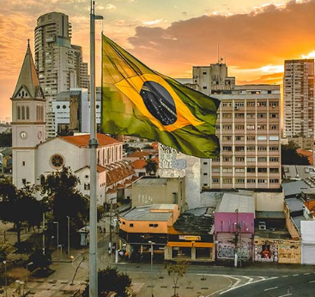
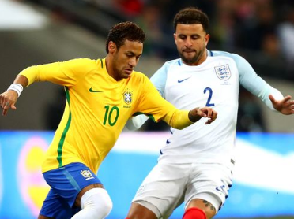
PSHE
Jigsaw – Being Me In My World
I know my attitudes and actions make a difference to the class team
I understand who is in my school community, the roles they play and how I fit in
I understand that my actions affect myself and others
Planning Grid
Year 3/4
Autumn 1 2021
Geography & History
Contrasting Localities
London, UK and Rio De Janeiro, Brazil
What are the differences and similarities in...
- environmental regions?
- land use?
- hills, mountains, coasts and rivers?
- types of settlement?
- imports and exports?
- distribution of natural resources?
- culture and interests?
Britain
meets
Art and Design
Print Making
Fabric Fastenings
Self-portraits
Brazil
Science
Sound
We will learn how to…
identify how sounds are made, associating some of them with something vibrating
recognise that vibrations from a sound travel through a medium to the ear.
find patterns between the pitch of a sound and features of the object that produced it
find patterns between the volume of a sound and the strength of the vibrations that produced it.
recognise that sounds get fainter as the distance from the sound source increases.
Literacy
Books to follow
The Giving Tree – Shel Silverstein
Cinnamon – Neil Gaiman
Numeracy
Place Value
Number Sense
Exploring Calculation
Counting on in 10s, 100s and 1000s
Reasoning with 2-, 3- and 4-digit numbers
Addition
Subtraction
RE
Hinduism
How do Hindus express their beliefs about God?
What is a shrine and why is it important in a Hindu home?
How do Hindus worship in the home?
What happens in a Mandir (temple)?
How is prayer central for a Hindu person?
PE
Basketball
Swimming

