Slide 1
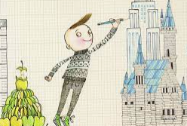
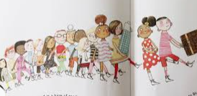
Year 1 – Summer 2 2022
Literacy
Continuing phase 5 reading focus
Drama and role play
Writing - Fiction
Iggy Peck
Architect – Andrea Beaty
- Labels and captions
- Character comparisons
Thought and speech bubbles
Poetry
One, Two, Buckle My Shoe
Hands by Julia Donaldson
Numeracy
Name coins and notes, understanding and representing values using different coins.
Find change
Share equally into groups
Doubling and linking halving to fractions, exploring arrays
Numbers 50 to 100.
Read, recognise and write numbers to 100.
Represent numbers to 100 as number bonds.
Represent numbers as groups of ten and ones in a place value chart.
Addition and subtraction within 100.
Science
Plants:
identify and describe the basic structure of a variety of common flowering plants, including trees
Computing
Programming B: Introduction to animation
Understand what algorithms are; how they are implemented as programs on digital
devices; and that programs execute by following precise and unambiguous instructions
Art
DKH Art Exhibition
Design Technology:
Mechanisms- wheels and axles
Pupils learn about the main components of a wheeled vehicle.
Experiment with mechanisms to help them develop their understanding of how wheels, axels and axel holders work. To problem-solve why wheels won't rotate.
Design and build their own moving vehicles.
PE
Obstacle course trials.
Moving in different ways – coordination, balance, poise.
Dancing – hop, jump, skip, jig, clap.
Sports workshops: Multiskills, Yoga
Whole School Event: Sports Day
On Our Doorstep!
Geography
Understand geographical similarities and differences through studying the human and physical geography of a small area of the United Kingdom
Use simple fieldwork and observational skills to study the geography of their school and its grounds
PSHE
Christopher Winters Project: Growing and Caring for Ourselves
Understand how growing helps children to learn new things.
Discuss changes that have happened in our lives.
Mindfulness - Expressing Gratitude
- Performing Acts of Kindness
Taking Mindful Action in the World
RE
How do you live well?

