Slide 1

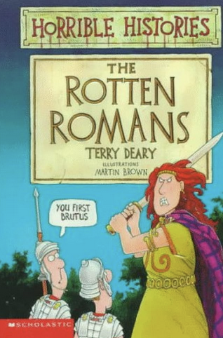



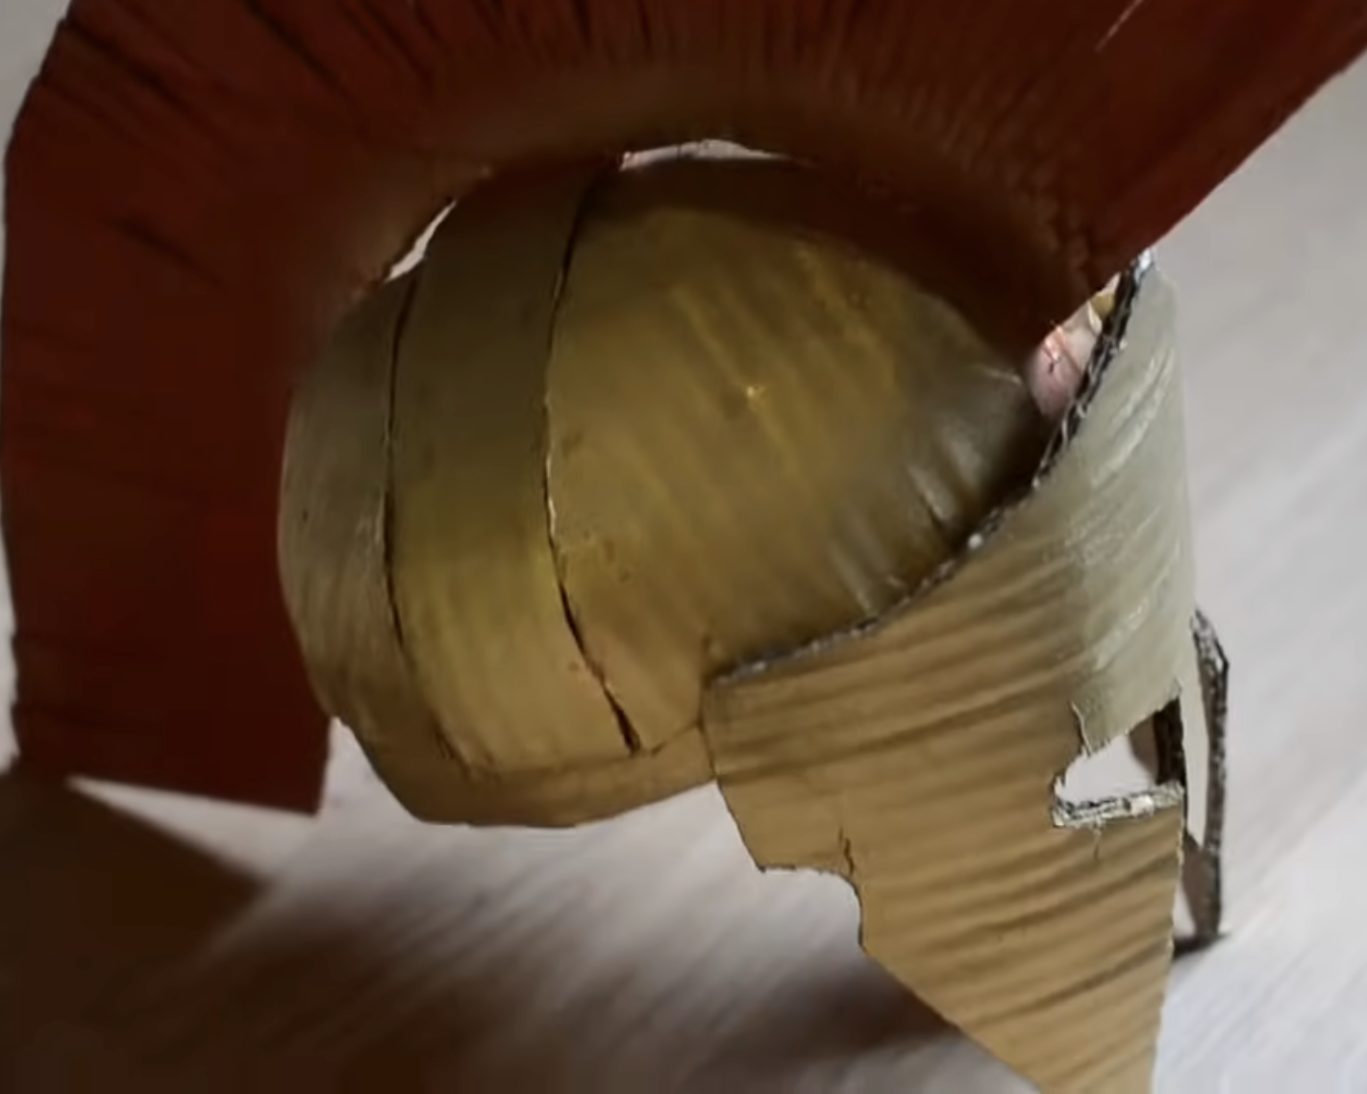


PSHE
What are human rights?
How to care for our environment
Importance of community
Topic Web
Year 4
Spring 1 2026
History
British life before the Roman invasion.
The Celts and Boudicca.
The Romans and the Roman Empire.
Roman army.
The impact of the Romans on Britain and British life.
Science
Digestion.
The parts and functions of the human digestive system.
Understanding the journey our food takes when we eat it.
Investigating teeth and their function.
RE
How important are our beliefs?
Importance of ceremonies
What items signify beliefs?
Religious fasting and dietary restrictions
RUTHLESS
ROMANS
Maths
Multiplication and division facts.
Fractions – representations of fractions, equivalent fractions, mixed numbers and improper fractions.
Time
Roman numerals.
Computing
Website safety: Staying safe online
Buying online
What is a bot?
What is fiction or truth?
Literacy
Escape from Pompeii by Christina Balit
Writing genres will include character descriptions, setting descriptions, narratives and report writing.
Grammar: Fronted adverbials, punctuation, sentence structure, verb tenses.
Design & Technology
Structures – Making a Roman helmet
How to strengthen the structure
Making a shell structure
Evaluate the structure
Apply our research to design and create a stable structure.
Music
Compositions – create, perform and analyse compositions.
Prepare for Orchestra Unwrapped at The Royal Festival Hall and
PE
Gymnastics
Dance
Improve technique and confidence
Spanish
Musical instruments – Instrumentos.
Determiners el, la, los, las.

