Slide 1
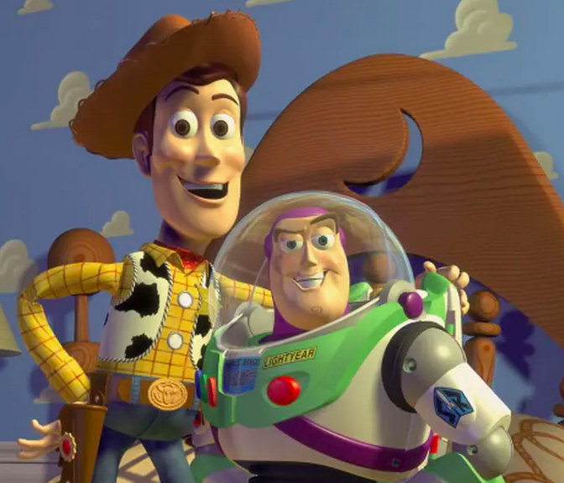
English - Writing
Non-fiction - Non-chronological reports and information texts.
Toys (links to history – changes within a living memory)
Non-fiction writing
Features of an information text.
Fiction – Lost in the Toy Museum by David Lucas
Recount
Phonics
Revise phase 3,4 and 5; blending and segmenting phonics to read words and spell.
Common exception words.
Topic Web Year 1 Spring 1 2026
Maths Mastery Scheme
Time – read, write and tell the time to o’clock and half past on an analogue clock. Sequencing daily activities. Whole and half turns.
Count, read, compare and order numbers to 50. Describe and complete number patterns.
Choosing, explaining and modelling addition and subtraction strategies.
Our Toy Story
D&T - Structures- Making a pencil pot
Understanding that structures are things that are built and have a purpose.
Understanding that structures with a wider base are more stable than ones with a narrow base.
Designing a product for a particular users.
Sketching out an idea
Choosing the best method for joining the parts of the product.
Make evenly spaced cuts
Use scissors to cut out a shape neatly and accurately.
Science - Everyday materials / Seasons
Distinguish between an object and the material from which it is made.
Identify and name a variety of materials, including wood, plastic, glass, metal, water, and rock
Describe, compare and group together a variety of everyday materials on the basis of their simple physical properties.
PE – Teambuilding Games
Physical team games, working together as a team, being kind and sharing.
Invasion Games
Invasion games working on coordination, balance, spatial awareness and gross motor skills.
Dance with Chantal from Pioneer Dance
Computing – Online safety
Discuss what the internet is and how it can be used
Recognise that the internet may affect mood or emotions
Recognise how internet can affect and upset others.
Identify what information is appropriate to share and post online and which is not.
PSHE – Health and Wellbeing
Naming and describing different feelings
Talking about what they are good at and something they want to improve.
Describing bedtime routine, and why sleep is important.
Explaining how rest and relaxation help our bodies and minds.
Knowing that germs can spread on our hands.
Knowing how to wash their hands properly.
Identifying three ways to stay safe in the sun.
Knowing that some people have allergies and how to help.
Identifying people who help keep us healthy.
Music- The long and the short of it
To develop children's ability to discriminate between longer and shorter sounds, and to use them to create interesting sequences of sound.
R.E - What is God’s job? Sharing ideas about what names for God show us about what God does. Talking about beliefs about God while respecting other’s views. Recognising that Jewish people believe they have a special relationship with God. Matching some of the 99 names to descriptions of what God does. Explaining why Jesus’ miracles are important to Christians. Recognising that some Hindus believe that God has many forms and what they show.
History
Toys
The children will learn how to sort toys as well as Identifying similarities and differences between toys made withing living memory.

