Slide 1
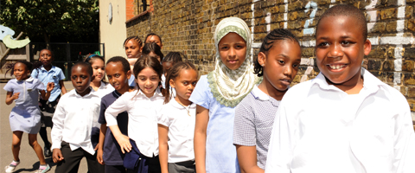
Secondary School Applications
Transfer date September 2027

Slide 2

When choosing a school, think about….
Specialisms: Think about the strengths and interests of your child. Schools sometimes have a specialism or strength.
Grammar schools require children to take the 11+
Religious school/non-religious.
Mixed or single sex.
Distance to travel.
School’s criteria.
SEND resource base or not?
Friendships

Slide 3
Types of secondary schools
Voluntary aided schools
There are two voluntary aided secondary schools in Southwark. The school’s governing body is responsible for their admissions and decides how pupils are admitted. (Notre Dame, St Saviour’s and St Olave’s School, St Thomas the Apostle)
Academies
There are 14 academies in Southwark. The Academy Trust is responsible for school admissions and decides how pupils are admitted.
Free school academies There are three secondary free school academies in Southwark. The school’s governing body is responsible for school admissions and decides how pupils are admitted (Compass, Haberdashers Aske Borough, Charter School -East Dulwich)

Slide 4
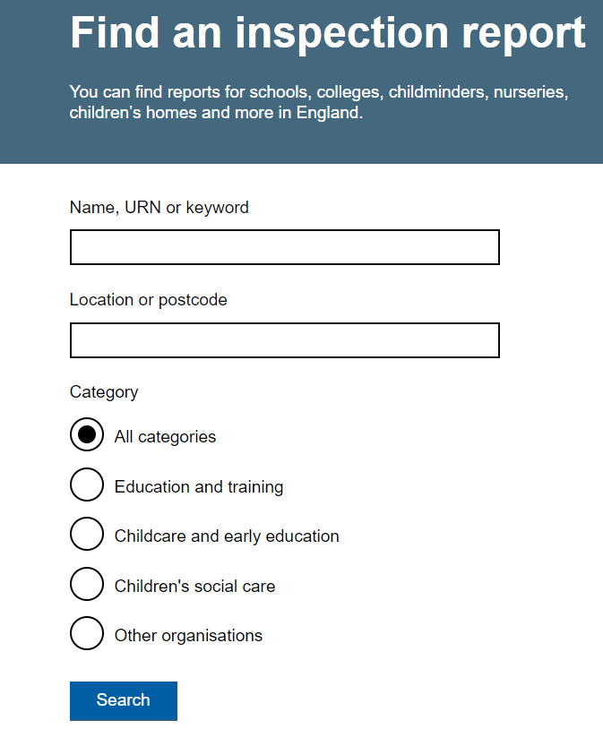
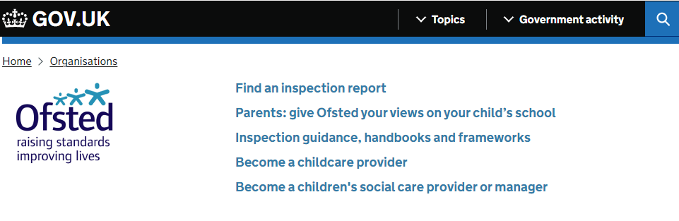
Before you choose your school
Look at school brochures and websites
Look at the most recent Ofsted Reports www.gov.uk/government/organisations/ofsted

Slide 5
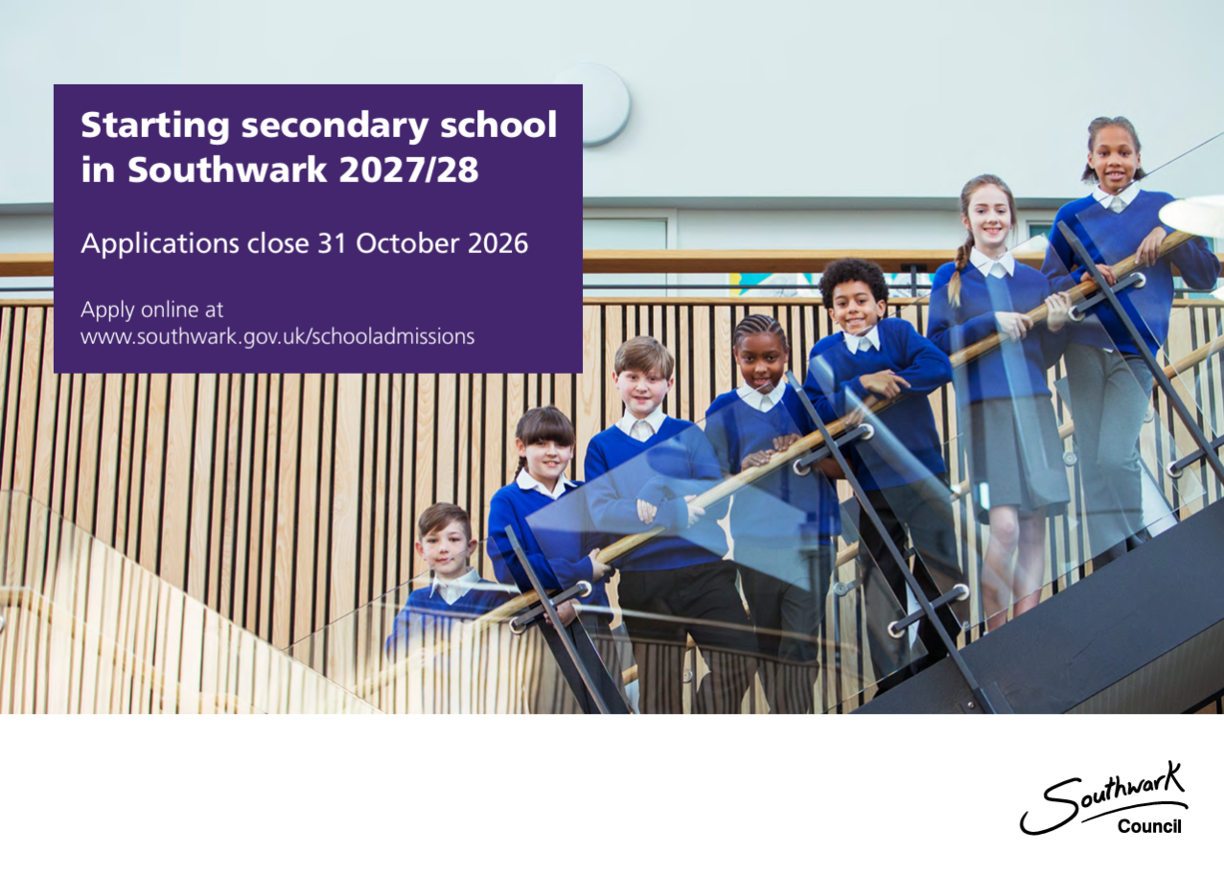

You will have been sent these brochures via email.

Slide 6
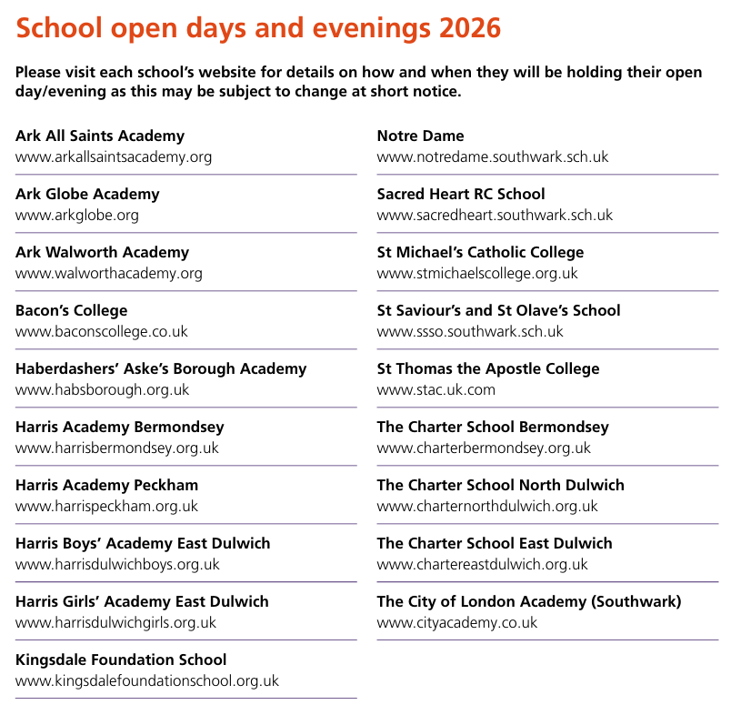
Southwark School Open Days
The Secondary School brochure does not include any open day dates, but Open days are often the first alert you will see when you look at a school’s website. Page 8 of the Southwark brochure provides a list of schools and the website link is a hyperlink.
Once you have shortlisted a few school you can then visit their websites to find out when the open days are.

Slide 7
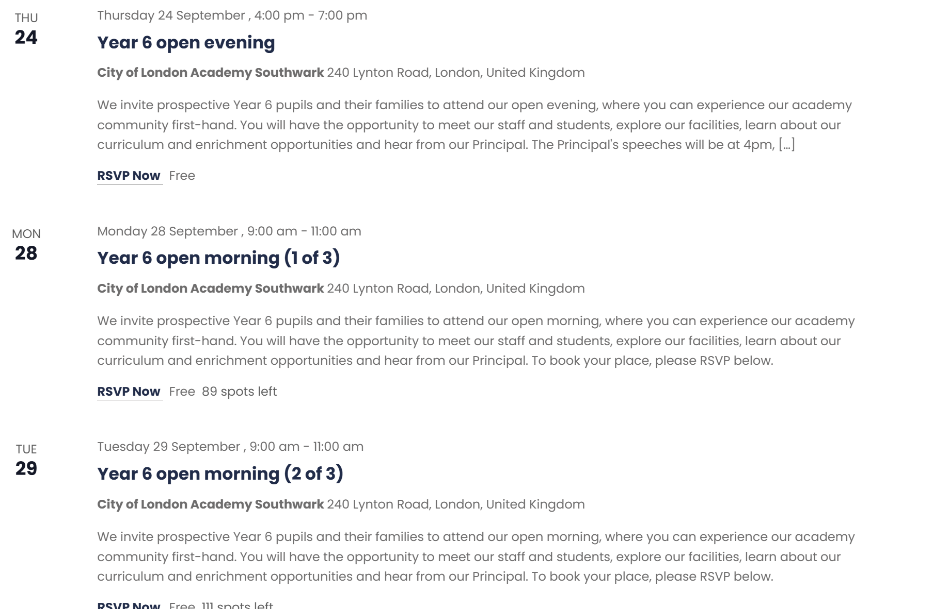
Open days are often the first thing you see on the websites.
They may ask you to click for tickets
e.g City of London Academy

Slide 8
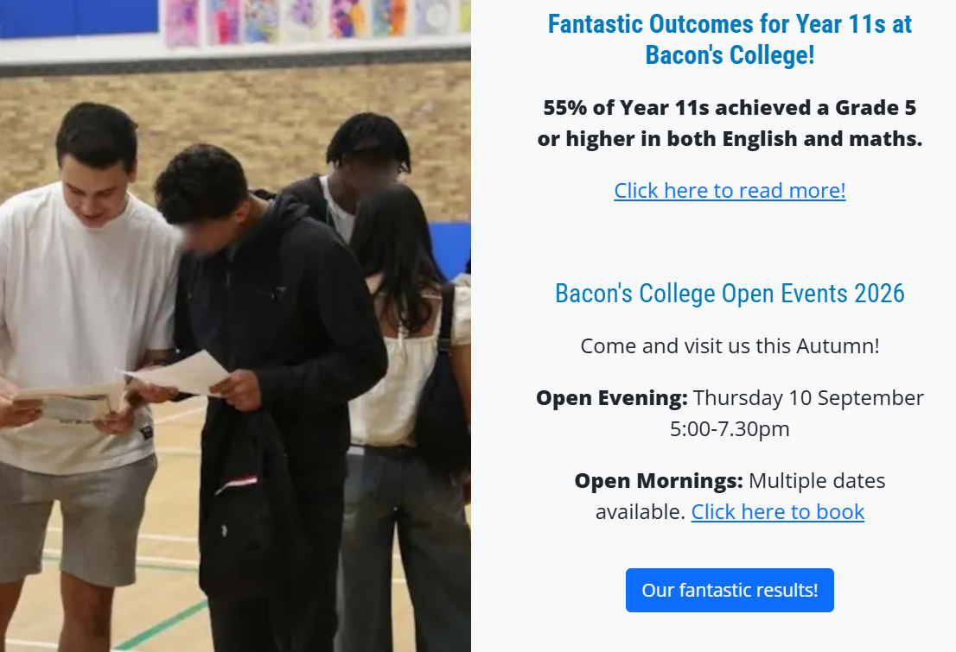
Bacon's College

Slide 9
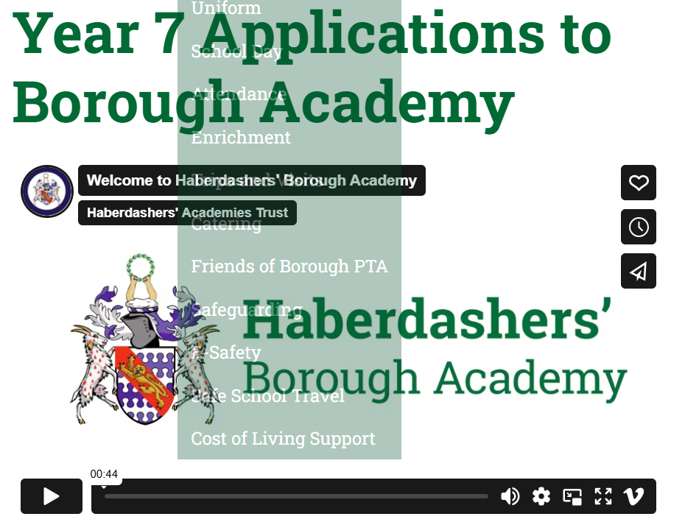
Some websites have admissions video- e.g Haberdasher’s Academy Trust

Slide 10
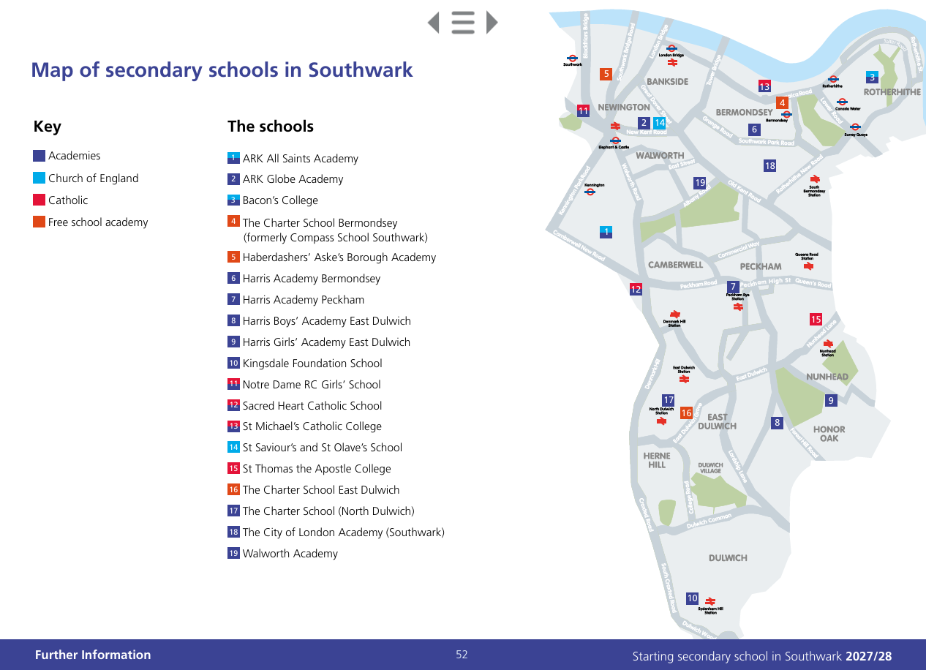
Consider how your child is going to travel to their new school.
Page 53 of the brochure provides a map setting out the secondary schools within the borough.

Slide 11
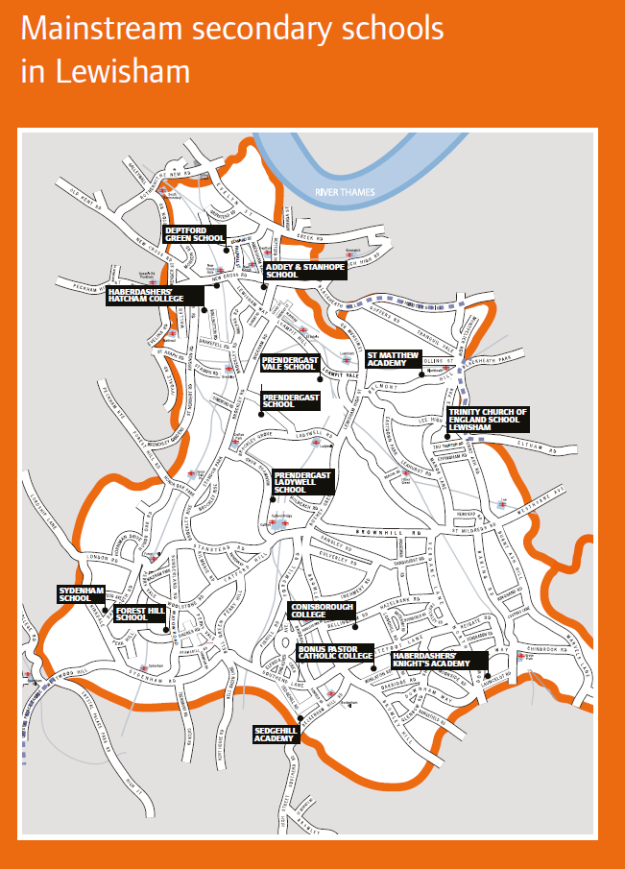
Page 2 of the Lewisham brochure.

Slide 12
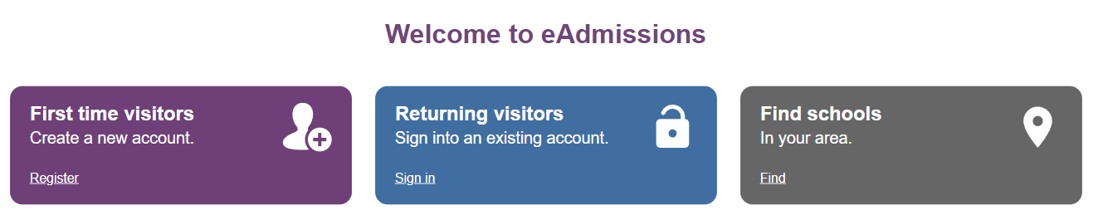
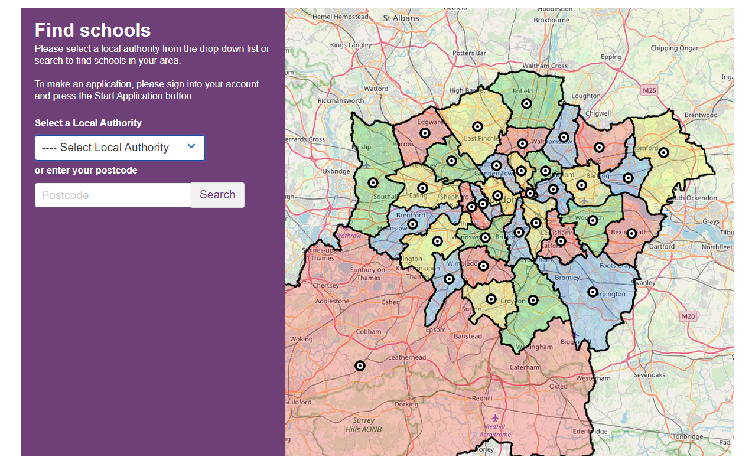
You can find schools across the country using the link on eAdmissions

Slide 13
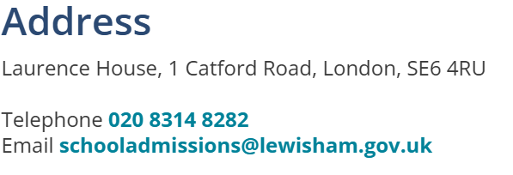
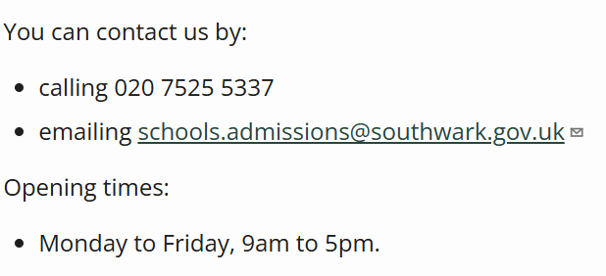
Local Authority Websites and contact details
Website link for Lewisham secondary school admissions:
https://lewisham.gov.uk/myservices/education/schools/school-admission/applying-to-start-secondary-school
Website link for Southwark secondary school admissions:
https://www.southwark.gov.uk/schools-and-education/school-admissions/secondary-admissions

Slide 14
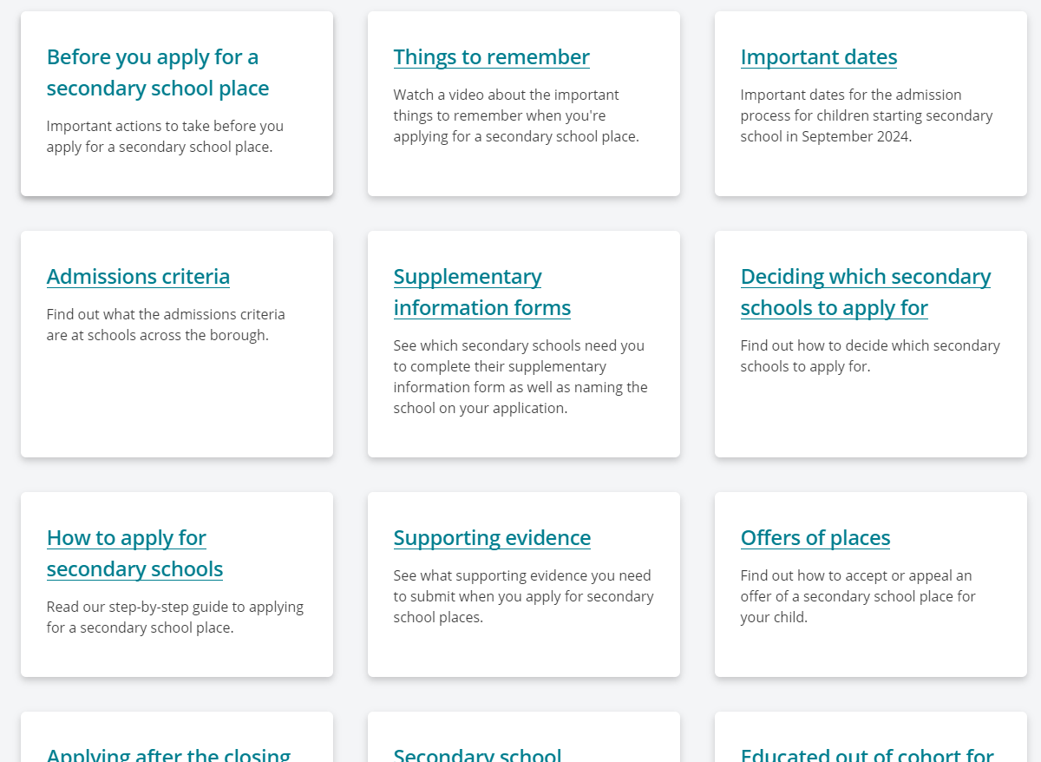
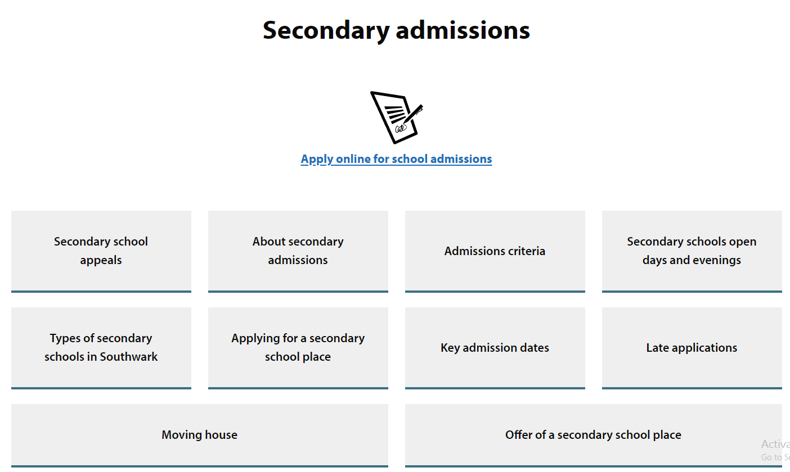
Links are easy to find on the LA website
This tab takes you to a list of all Lewisham schools and provides open day information
This tab takes you to a list of all Southwark schools and provides open day information

Slide 15
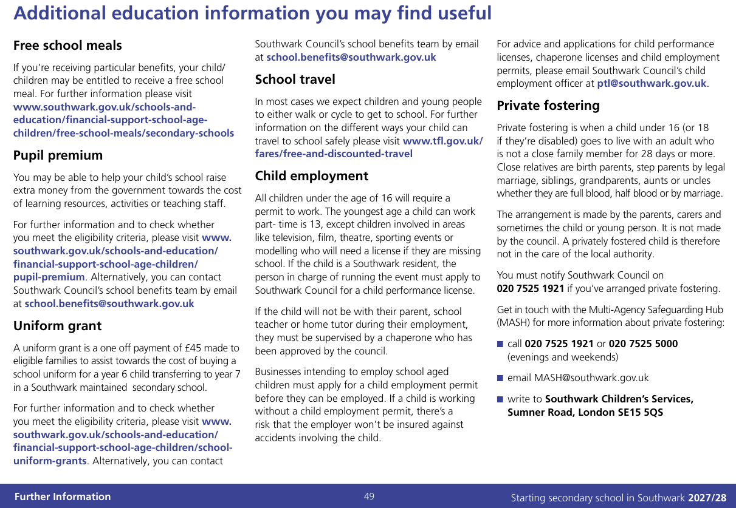
There is lots of additional info in the Southwark brochure do have a read

Slide 16
Key Dates to Remember
You can apply online from 1st September 2026
Closing Date: Saturday 31 October 2026, 11.59pm
Aim to have completed your application by Friday 30th October 2026

Slide 17
Confirmation of school offer
Applicants who apply on time will receive their child’s offer of a school place by email on Monday, 1st March 2027 after 5pm. This email will also include information on what to do next.
Applicants can also view the outcome of their application during the evening at www.eadmissions.org.uk

Slide 18
Rejecting an offer
Rejection: Monday, 15th March 2027 rejection of offers must be returned by this date or they will automatically be accepted.
Should you wish to reject the offer of a school place allocated to your child, you must notify the school admissions team by email at schools.admissions@southwark.gov.uk and include your unique application reference.
Waiting list that remain open until the 10th July 2027. If offered a place on a waiting list you have 5 days to accept the offer.
Appeals: Check dates of appeal hearings with individual schools. For further information about the appeals process contact Southwark Council’s school admissions team on 020 7525 5337 or by obtaining a copy of the School Admissions Appeals Code from the Department for Education (DfE), contact details on page 48 of the brochure.
If you miss these dates, your chances of being offered a place at a preferred school will be reduced.

Slide 19

How to apply
If you are a Southwark resident up through
https://www.southwark.gov.uk/schools-and-education/school-admissions
Lewisham resident:
https://lewisham.gov.uk/myservices/education/schools/school-admission/applying-to-start-secondary-school/secondary-school-admissions-preference-system
https://www.eadmissions.org.uk/
Southwark Council
libraries offer free access to the internet.
Visit:
www.southwark.gov.uk/libraries or call
Southwark Council’s customer service centre on
020 7525 5000

Slide 20
To set up an account
You will need an email address – google mail preferable
You will need to set up an account on e-admissions

Slide 21

Preferences
You are given the opportunity to express up to 6 preferences for your child’s school placement.
Make sure that your child meets the schools entrance requirements.
Your child may not get your first choice so make sure you do include other preferences.
You can select 6 schools whether they are in Southwark or within a different borough.

Slide 22
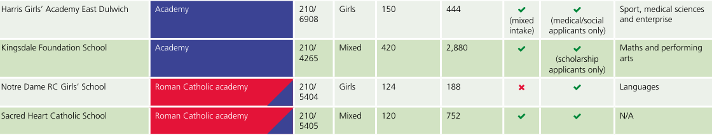
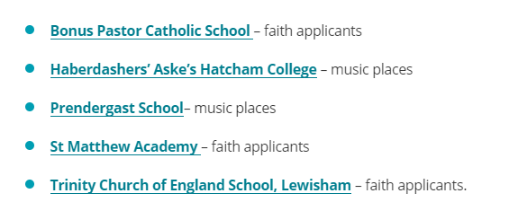
Supplementary Information Form
Referred to as the SIF
You must complete a supplementary information form (SIF) if the school you have listed as one of your preferences requires this.
It will appear on Southwark’s ‘Schools detail’ page if the school requires one.
Lewisham schools that require a SIF

Slide 23
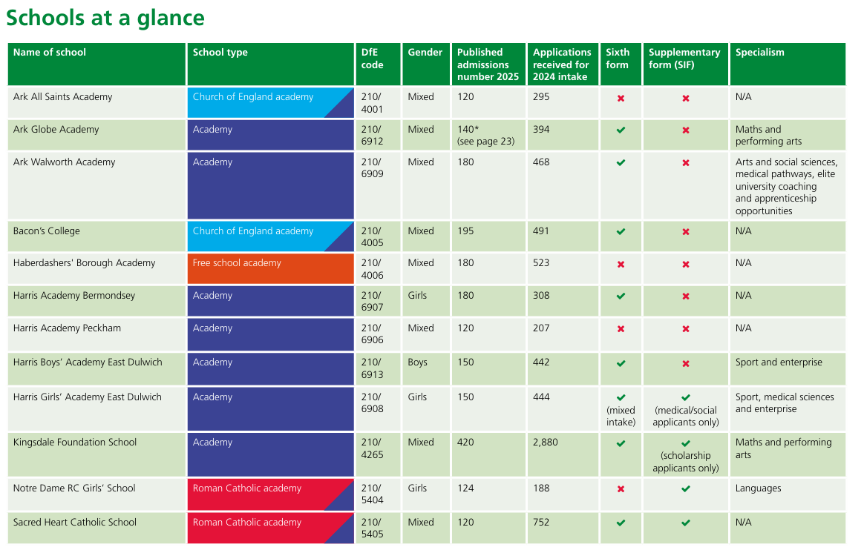
SIF
Specialism

Slide 24
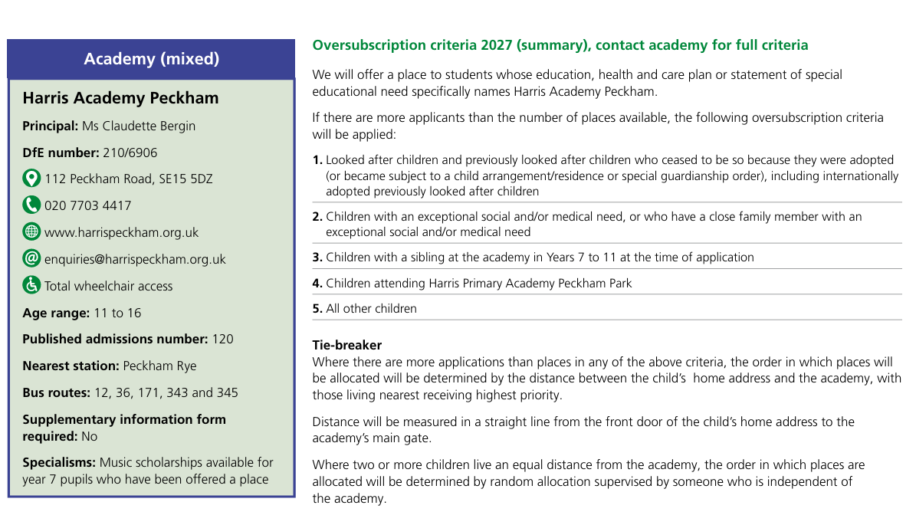

Slide 25
Ability, aptitude and banding tests
If you are applying to a secondary school that uses banding within its criteria, your child will be required to take a test. Please contact the school directly for further details on banding test arrangements.
If you are thinking of applying to a secondary school that tests a child for ability/aptitude for the purposes of admission, you must ensure that you register your child for the test before each school’s published deadline and you must also submit your child’s online admissions application by 31 October 2026. Please check each school’s website or contact the school directly for further information about their test date and arrangements.

Slide 26
Medical/Social Reason
If you have ticked the ‘social/medical’ box, you must provide additional information to support your application such as a recent medical/social report or letter from a professional. (This will need to be uploaded.)
You must ensure that you click ‘Next’ each time you complete a page of the application or your information will not be saved

Slide 27
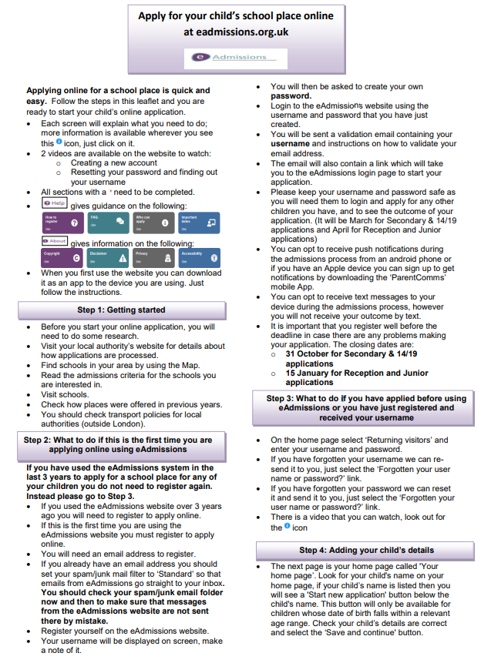
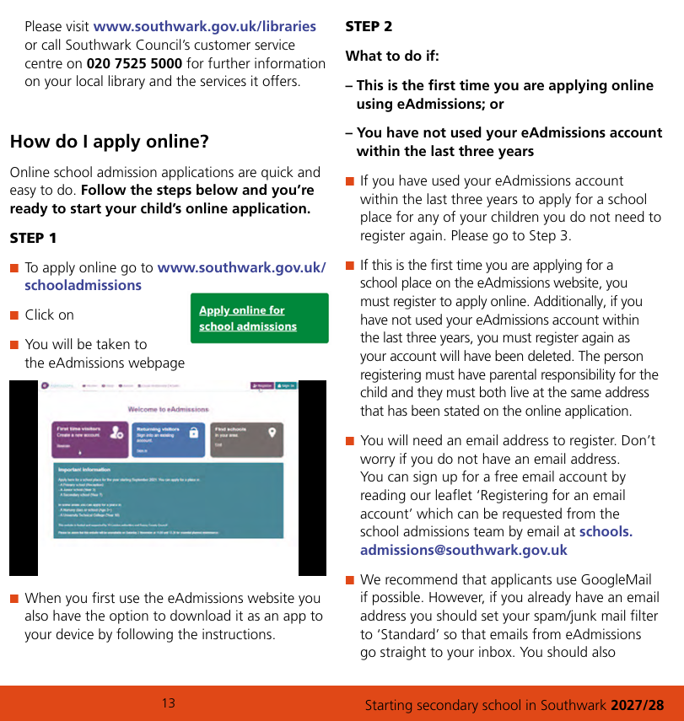
Guidance
Southwark in their brochure
Lewisham’s online

Slide 28
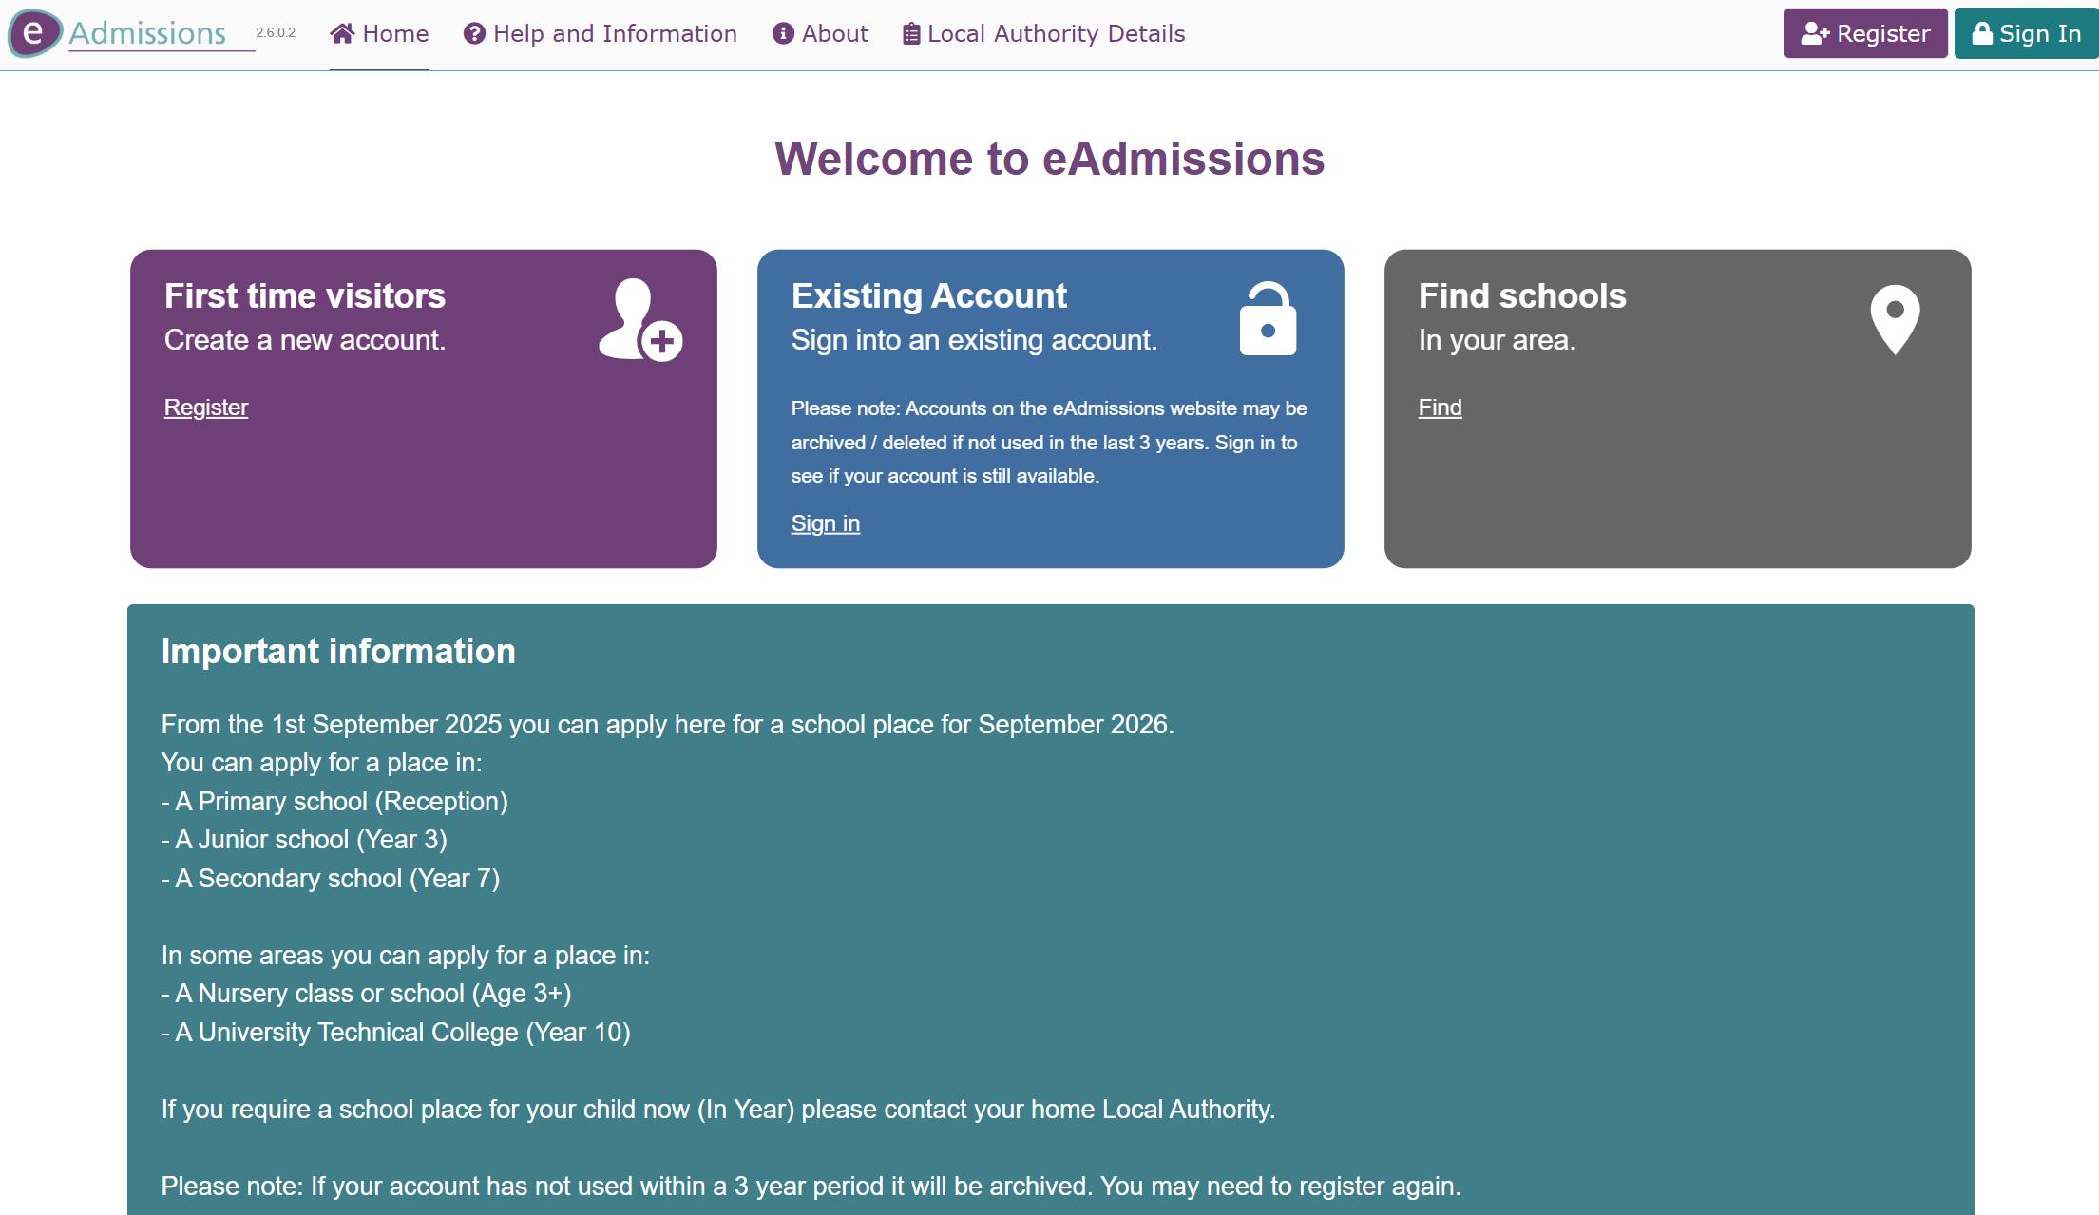
https://www.eadmissions.org.uk/

Slide 29
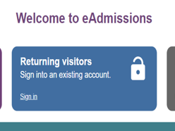
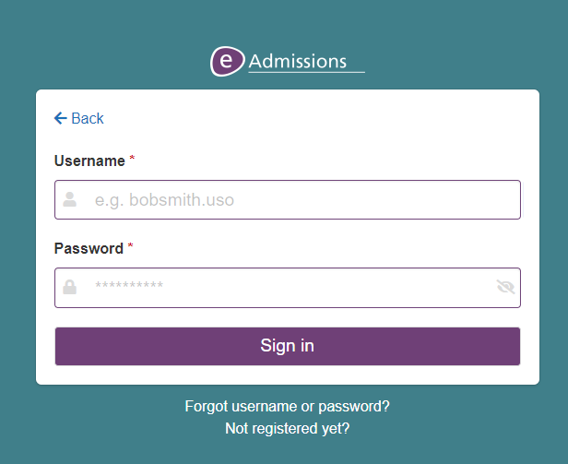
If you already have an account you have used within the past 3 years, login will be required so keep your username and password safe
‘Forgotten your user
name or password?’ link and follow the
instructions. Your password can be re-sent to you by text message or to the email address you used when you first

Slide 30
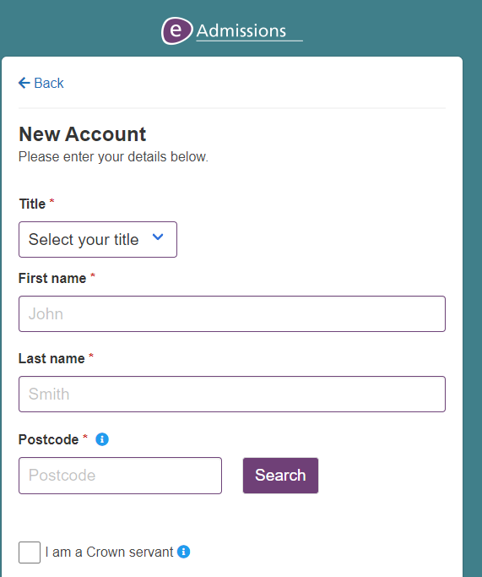
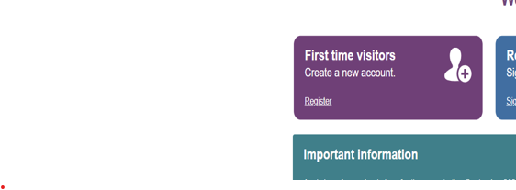

Slide 31
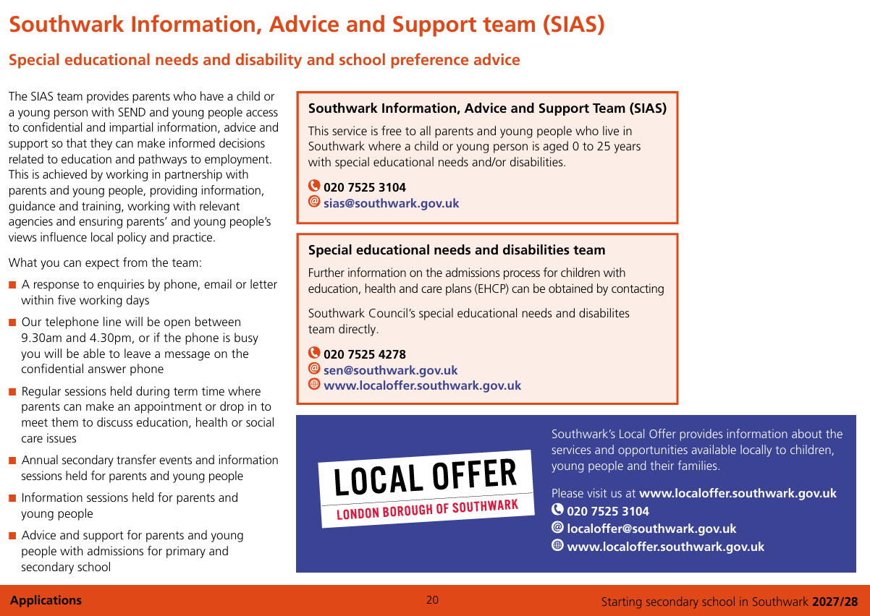

Slide 32

Southwark Information Advice Support team (SIAS)
This service is free to all parents, carers and young people who live in Southwark and parents who have children attending schools in Southwark.
Drop-in sessions
More information
Telephone 0207 525 3104
email sias@southwark.gov.uk
visit our local offer web page

Slide 33
When applying
If your child has a sibling (brother or sister), at one of your preferential schools, please ensure that you tick the sibling box.
Once you have completed your online application use the ‘Submit Application’ button to submit your application.
You should receive an email with your 16 digit application reference number starting with 210 similar to this: 210-2024-09-E- 123456.
If you do not receive a unique reference number it means your application has not been received and you will need to resubmit your application.
Keep a record of your unique user name, password and application number which you will use for your application. It is important to keep this information safe so that you can log in and look at your application and review the results

Slide 34

Late applications
If you are making a late application between
1st November 2026 and 18th August 2027, you must complete and submit an online application at www.eadmissions.org.uk
All late applications received after 31st October 2026 (except those regarded as exceptional circumstance) will not be considered for a school place until after the initial offer of places on 1st March 2027.

Slide 35
Late applications after August 27
If you are making a late application after 18th August 2027, you must apply for an in year place for your child, as the online application system will no longer be available. You can find further information about the in year admissions process at https://www.southwark.gov.uk/schools-and-education/school-admissions/year-admissions

Slide 36
Southwark Admissions
School admissions team 4th floor,
Hub 2 Children’s and adults services Southwark Council
PO Box 64529
London SE1P 5LX
www.southwark.gov.uk/schooladmissions
Email: schools.admissions@southwark.gov.uk
Phone: 020 7525 5337

Slide 37
Lewisham Admissions
Admissions Team
3rd Floor
Laurence House
1 Catford Road
London
SE6 4RU
Phone: 020 8314 8282
Email: schooladmissions@lewisham.gov.uk

Slide 38
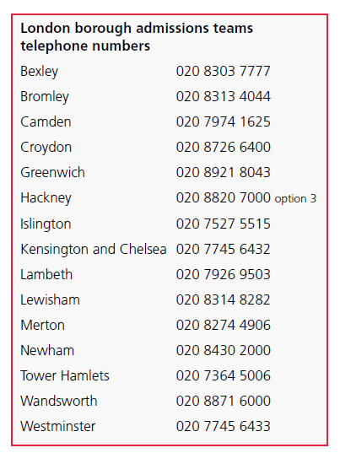

Slide 39
Online Application Support
If you require further support with your application, please contact the school office to make an appointment and we will endeavour to help you in any way we can.

