Slide 1
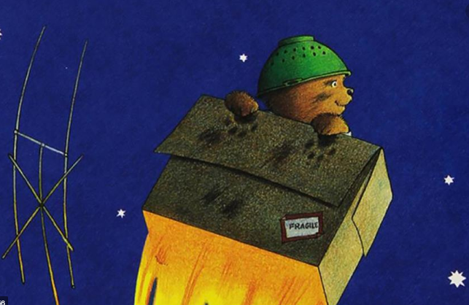
PSHE Learning about the brain
Introduction to Brain Breaks/Mindful Breathing
Jigsaw PSHE: ‘Being Me In My World’ & ‘Celebrating Differences’
Topic Web – Year 1 – Autumn 1 2026
English
Writing
Writing based on " Beegu" by Alexi Deacon, “Whatever Next” by Jill Murphy
Drawing and labelling a story map
Writing a list using simple adjectives
Writing a postcard - use and to join words and clause.
Poetry – to listen and identify poetic features of a poem
Numeracy
Following the Mathematics mastery scheme
Numbers to 10
Count, read, write, identify, represent, double and half and use comparative language
Addition and subtraction within 10
Represent and use number bonds; read, write, interpret, represent and solve
Shapes and patterns
PE
Each lesson will be built around a scenario that will focus on a different aspect of physical development culminating in teamwork
Running, jumping, balancing, climbing and teamwork
Fundamental movements, balancing skills and dance
Reach for the Stars!
Music
use their voices expressively and creatively by singing songs and speaking chants and rhymes
Science
Learning about animals including human beings.
Identify, name and label parts of the body
Identify the 5 senses (sight, taste...)
Say which part of the body is associated with each sense
Find and name common animals that are birds, fish, amphibians, reptiles, mammals and invertebrates
Find and name common animals that are carnivores, herbivores and omnivores
History
Learning about the lives of significant individuals in the past who have contributed to national and international achievements.
Learning about Neil Armstrong and the Apollo 11 mission to the Moon
Learn about the achievements of the first black woman in space (Mae Jemison)
Black History Month
5,4,3,2,1..blast off!
Computing
Define and use technology
Mouse and keyboard skills
Computer safety
Discussions about staying safe online
RE
• Identify things which are natural and man-made.
• Discuss ideas about how natural things were created.
• Recall the key elements of the Jewish and Christian creation story in the correct order.
•Understand that some Christian and Jewish people believe the story explains how the world was created.
• Correctly order the key events of a Hindu creation story.
• Make some links between the Hindu creation story and the Christian and Jewish creation story.
• Share their own ‘I wonder’ questions.
• Recognise that Humanists use evidence to understand how the world began.
•Create a thoughtful representation that reflects the Humanist belief of how the world began.
Art and Design
Drawing: Make your mark
Explore mark making and line; work and experiment with different materials through observational and collaborative pieces.

