Slide 1




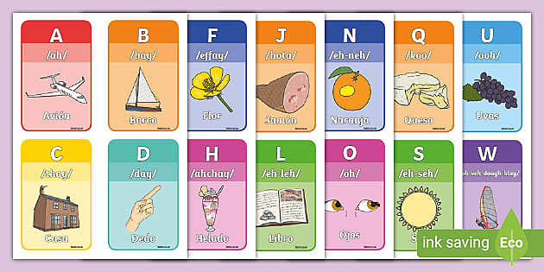
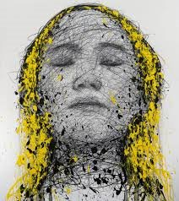


Topic Web – Year 5 – Autumn 1 2026
Vicious Vikings
PSHE (Getting Focussed)
To create a class charter
To understand how our mind works.
To understand how to be mindfully aware.
To understand the zones of regulation
To understand how to respond empathetically in complex social situations. - To apply empathy to real-life school or community situations
Literacy The Lost Thing
Write a diary entry
Create a short narrative
Author study: Shaun Tan
(Beowulf &Grendel)
Write a character and setting descriptions
To write a fantasy story based on the story of Beowulf and Grendel
To write a playscript and an eye-witness account.
Numeracy (Place value, Addition and Subtraction)
Read, write, order and compare numbers to at least 1000000 and determine the value of each digit.
Count forwards or backwards in steps of powers of 10 for any given number up to 1000000.
Interpret negative numbers in context, To add and subtract whole numbers with more than 4 digits with problem solving.
PE (Netball Skills)
PE will be taught on a Thursday morning by Millwall Football Club
Art and Design Portraits
Investigate self-portraits by a range of artists,.
Look at the art of Hom Nyguyen
Spanish
To revise Spanish phonetics. La fonetica
Shared Reading Texts
Lion, the Witch and the Wardrobe
Beowulf
History (The Vikings)
To understand where the Vikings came from.
To understand how and why the Vikings invaded England.
To understand how Vikings lived and worked.
To understand what happened during the Viking invasions and know what Viking warriors were like.
To identify and describe Viking artefacts.
To know some Viking Gods and what they represent.
To understand how some Kings in Britain dealt with Viking Invaders.
Science (Properties of Materials)
To be able to compare and group together everyday materials based on evidence from comparative and fair tests; including their conductivity of heat.
To give reasons based on evidence from comparative and fair tests.
To take accurate measurements using a data logger.
RE (Why doesn't Christanity always look the same?)
Give examples of how Christianity spread as a religion.
Explain how significant people have led to changes in how Christianity is practiced.
Think about their views on leaders changing the way religion is practiced.
Computing
Alleynes will be teaching Computing weekly

