Slide 1



Aims:
Year 6
Parent Curriculum Meeting
Year 6 Team
Teacher: Roshni
Teaching Assistants: Maxine
Grove Primary
Opportunity to meet your child’s class teacher
Opportunity to hear about what your child will be learning and how you can be involved
Date: 8th September 2026

Slide 2
Our Vision
Our Values
Creativity
Ambition
Resilience
Empathy
Respect
Courage
Within the Nexus Schools Education Trust (NEST), we aspire to create a supportive environment for personal growth and where enquiring minds develop a passion for learning.
“Respect, Ready, Safe”

Slide 3


School Day
Play Time
Drop off arrangements:
The gate on Grove Hill Road will open at 8:45am. Children and parents/carers should enter through this entrance. There is now a single point of access by the pedestrian crossing
Parents/carers should accompany children into the playground and children will proceed directly to their classrooms.
Parents/carers should exit the premises via the gate on Grove Hill Road.
Year 3 classroom has now moved upstairs.
Nursery and Reception have now moved into the main building downstairs.
Please note that children who arrive after 9:00am should enter via the school office and will be marked as late.
Collection arrangements:
Children in Years 1-6 should be collected at 15:30. School gates will open at 15:25. Parents/carers should enter the school via Grove Hill Road.
Parents/carers are asked to collect their children and promptly leave the school premises via the gate on Grove Hill Road.
We respectfully ask that parents/carers are not on mobile phones when they drop off and collect their children. This is a great time to engage with you child and enquire about their day.
Year 4,5, & 6:
playtime at 11:00 – 11:15
Lunch Time
lunchtime at 12:15 – 1:15

Slide 4

Homework
Homework is set regularly and will now take the form of online learning. In year 6 as we progress towards SAT’s homework may be given to take home.
Although homework is not compulsory, we would like to encourage children to complete homework tasks as it promotes independent learning skills and positively impacts on progress.
Your support is greatly appreciated.
Home Reading
Children will be given home-school reading books in order to support them with their progress in reading. These should be returned on Thursdays with new books given out on Fridays.
Reading with, and to, your child at home is the best way to ensure that they make progress in this vital skill. Children may also have access to the library to choose books to read in school.
There is more support available on the school website to support reading at home.

Slide 5

On-Line Learning
IXL: Homework platform
Times Table Rock Stars will support your child in learning times tables and associated division facts as well providing them with an opportunity to create their own avatar and earn certificates as they progress.
Year 6 Booster sessions: dates and pupils selected to be confirmed

Slide 6
Ways Parents and Carers can Help
Encourage children to write regularly including: cards, lists, letters, stories, postcards, fact files. Celebrate clear, cursive handwriting.
Read with your child as often as you can and ask them questions so that they can interrogate the text. Encourage a love of reading!
Support your child with the weekly homework tasks.
Use the local library.

Slide 7
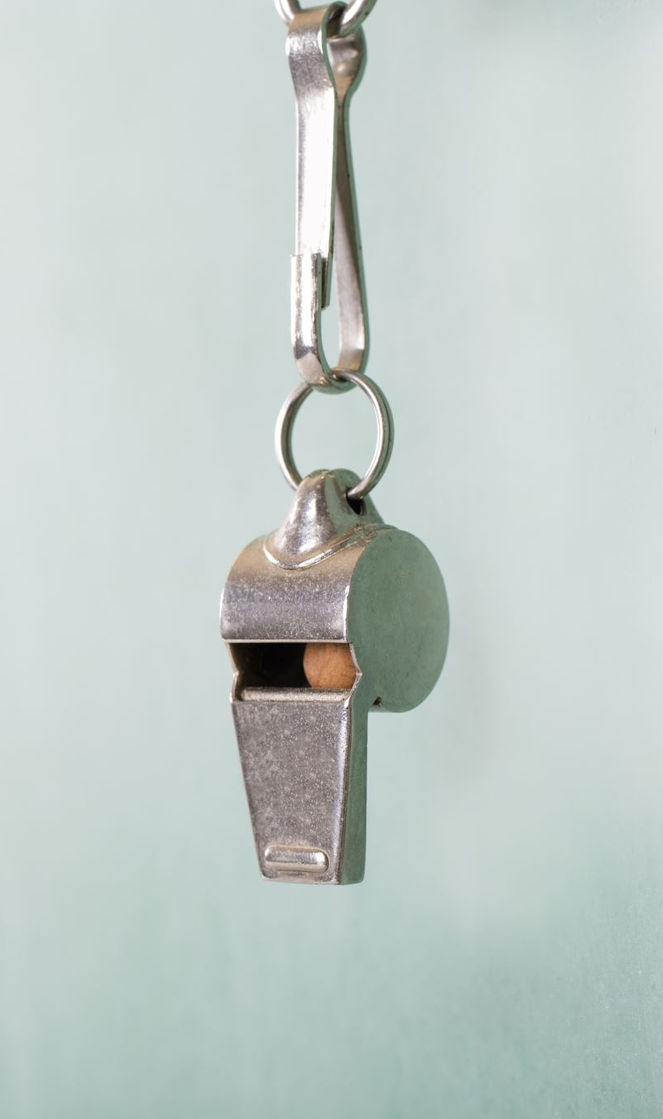
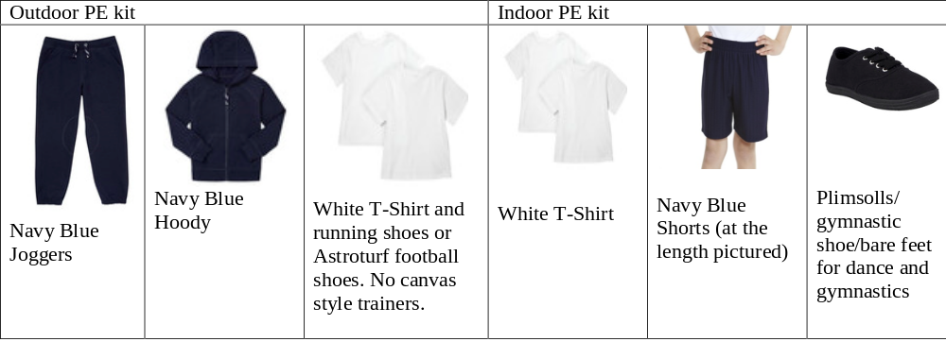
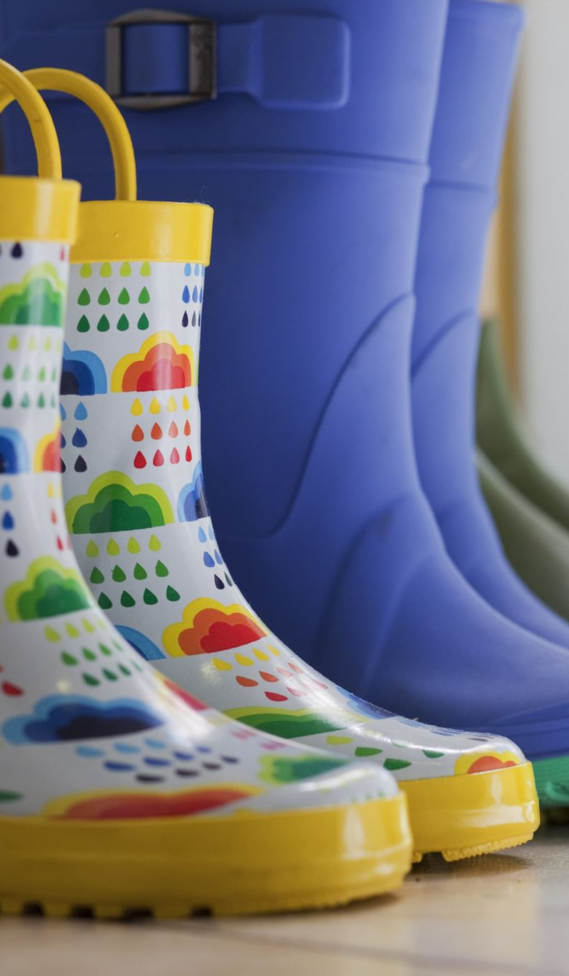
Please remember:
PE Days
PE takes place on Friday
Millwall will deliver and support PE development and training.
Water Bottles: Every child must bring in a water bottle, clearly labelled with their name and class.
Shoes: If your child is not able to tie their own shoelaces, we ask that parents ensure they wear Velcro shoes.
Hair: Children’s hair that is longer than shoulder length must be tied up.
Bags: Children should bring their own school bags that can fit their personal belongings including jumpers and water bottles.
Earrings: For health and safety reasons, children should not wear hooped or dangly earrings. Studs are acceptable.
Watches: Smartwatches are not permitted in school.
Please make sure that your child is wearing the correct PE uniform. This includes:
Outdoor shoes must not be canvas to prevent ankle and foot injuries. AstroTurf football shoes are recommended for those that play football regularly as they are hard wearing, otherwise running shoes are the most comfortable and supportive
PE Lessons:
It is best that children bring both indoor and outdoor kit for all lessons just in case we have to change the venue of the lesson because of the weather.

Slide 8

Mobile Phones:
Children in Year 5 and 6 who have a phone will put their phones in their class phone box which is kept at the Office all day.
We have a new mobile policy and we will adapt our practice according to the DfE expectations.
We are asking for parents to not use their mobile phone on site during drop off and collection to support in this.

Slide 9
Home - School Agreement
Parent / Carer:
To help my child at school, I will do my best to:
Make sure that my child attends school regularly and inform the school of the reasons for any absence
Make sure my child arrives in school on time and is collected on time
Support the school in maintaining good behaviour and discipline
Attend open evenings for parents.
Ensure that my child dresses appropriately for school
Let the school know if there are any problems that may affect my child’s ability to learn.
Provide healthy lunch choices, if my child brings in their own lunch
Support my child with homework and other home learning opportunities and listen to my child read / read to them (at least 10 minutes per day)
Strive to maintain a positive partnership with the school, even in difficult times.

Slide 10
Home - School Agreement
Pupils:
I will do my best to:
Work hard and listen carefully to instructions
Come to school regularly and be on time
Keep to the school rules and behave well
Demonstrate the school values and be an ambassador for Grove Primary
Do my homework regularly and bring my reading/phonics books and back to school
Dress appropriately for school
Wear my PE kit to school on days that I have PE lessons
Take good care of the school environment
Work hard to achieve my targets and aim to beat them
Do my best and work hard
Strive to follow the class moto of being ‘Respectful, Ready and Safe’

Slide 11
Home - School Agreement
School:
Will do its best to:
Encourage your child to do their best at all times
Encourage your child to do their best at all times
Expect the best from your child in behaviour and work
Inform parents and carers regularly how their child is progressing
Inform children, parents and carers what the teachers aim to teach your child each term
Take reasonable steps to ensure the safety, happiness and self-confidence of all your child
Be open and welcoming at all reasonable times and offer opportunities for parents and cares to become involved in the daily life of the school
Set, mark and monitor homework tasks regularly in keeping with the school’s policy
Contact parents and carers as soon as possible if we are concerned about your child’s learning, progress or behaviour
Contact parents and carers if there is a persistent problem concerning your child’s attendance or punctuality
Offer a broad and balanced curriculum which meets the needs of your child (the curriculum may be adjusted depending on DfE guidelines)
Provide healthy lunch options
Listen to your child’s ideas and encourage them to speak out
Encourage your child to keep fit and active
Challenge your child and ensure that they does their best
Ensure your child understands the teacher and any curriculum covered
Maintain a professional and positive partnership with parents and carers, even in difficult times.

Slide 12
Rewards
In our classrooms and around our school we have several ways in which we praise children for their positive behaviour:
Dojos
Star Certificates

Slide 13
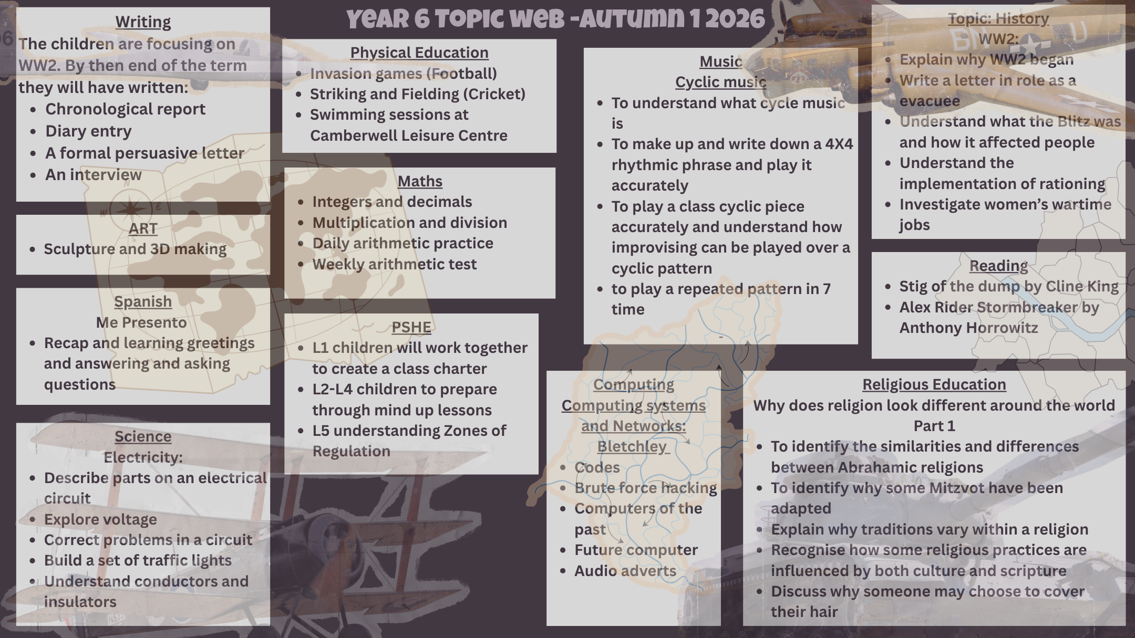

Slide 14
RSE
Relationships education is statutory in all primary schools in England. In line with government guidance.
We will continue delivering the Christopher Winter’s Programme. CWP's success is based on a thorough understanding of what constitutes effective teaching and learning for both teachers and pupils. They have been awarded the Award for Excellence in SRE.
A video of frequently asked questions is available on the Christopher Winters Project Website.
Lessons are delivered in the Summer Term 2
The focus is on science and changes and an overview of all lessons is available on our website in addition to a video of FAQs.

Slide 15

High standards of behaviour:
The Governors strongly believe that high standards of behaviour lie at the heart of a successful school. Good teaching and learning promote good behaviour and good behaviour promotes effective learning. Children have the right to learn and to achieve their full potential in all aspects of their lives, and staff have the right to teach. Governors also believe that the expectation of high standards of behaviour which are required during the school day can have a positive effect on the life of young people outside school in encouraging them to become successful citizens.
We continue to use Zones of Regulation across the school as well as providing and encouraging the use of reflection boxes in each classroom. Children take part in regular brain breaks and mindfulness sessions.
The school has a behaviour policy which can be found on our school website.

Slide 16
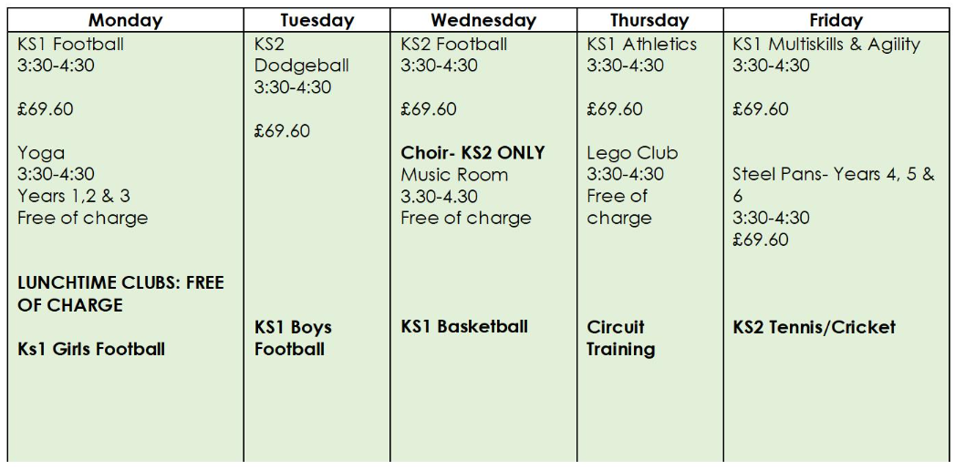
School Clubs
Autumn Clubs
Some club letters were sent out at the end of the Summer term and will be sent out at beginning of every term. Payment is made on Arbor. Please speak with the school office if you have any questions.

Slide 17
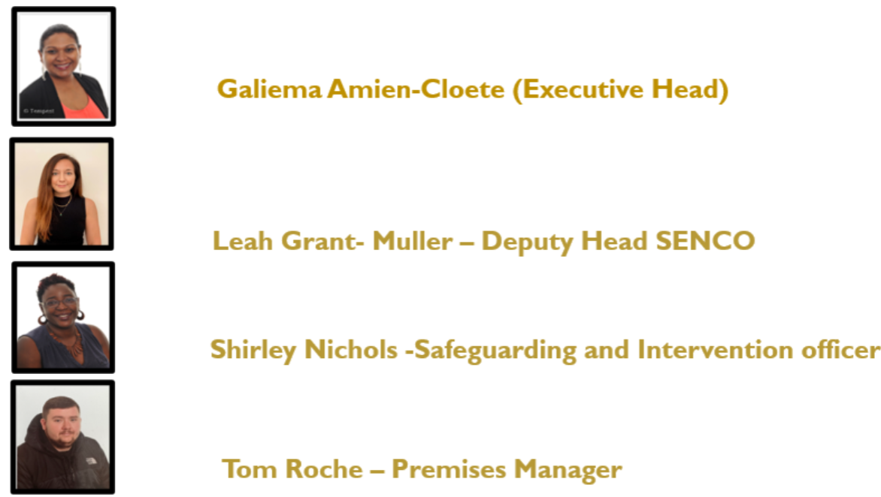
Meet the safeguarding team!
The role of the safeguarding team is to manage all matters of safeguarding and child protection across the school. This may mean having a discussion with you regarding the wellbeing of your child. The team works in a non-judgmental, supportive way and can signpost you to agencies that offer guidance and support for you, your child or your family.
We know that all families, at some point in their lives, face difficult times. The team is not there to judge but to empower you to work in partnership with them and outside agencies in the best interest of your child. Alternatively, if you wish to enquire about services they offer, please do not hesitate to contact a member of the safeguarding via the main school office.
Areas that the team can offer support or guidance on:
poor attendance
welfare
wellbeing
mental health
decreasing risk or harm to
you or your child
support for you if you are
a victim of domestic violence

Slide 18
Communication
At Grove Primary we work hard to foster positive relationships with parents, carers and the wider community. We understand good communication will promote this. We will communicate with you via:
Weekly Newsletter sent via email
The school newsletter is our main form of communication. It serves as a comprehensive source of communication, consolidating key announcements, updates, and events in one centralised place. It is designed to ensure that all members of our school community, including parents, pupils, and staff, have access to the same information simultaneously
Directed letters (on occasions)
Termly Coffee mornings
School Website: www.dkh.org.uk
Text messages (on occasions)
Contacting through the school office
Office Reception hours will be from 9:30am – 3:00pm and 3:30 – 4:00. Parents and visitors will not be accommodated in the office outside of these times as that will affect children’s start and leaving times. Please note that the last query before 3:00pm is at 2:50pm to allow staff to prepare for dismissal.

Slide 19
Who do I speak to?
Class Teacher (Teachers will attempt to respond within 3 days)
You should email the class teacher in the first instance, to discuss:
*How to support learning
*Social, academic, and personal progress
*Classroom and playtime incidents
*Organisational issues e.g. lost property which is not in the lost property area
Phase Leader:
Lower School: EYFS, Years 1, 2 speak to Jo McCoy
Upper School : Years 3, 4, 5 and 6 speak to Darren Lalchan
You can email or telephone to arrange an online appointment via the office to:
Discuss any ongoing concerns or unresolved issues in the first instance before speaking to the Head of School
Deputy Head:
You should contact Leah Grant
lgrant@dkh.southwark.sch.uk to discuss:
*Unresolved issues after speaking to the Class Teacher and Phase Leader
*Safeguarding issues
Executive Head:
You should contact Ms Galiema Cloete
head@rotherhithe.southwark.sch.uk to discuss:
*Unresolved issues after speaking to the Head of School
*Safeguarding issues as mentioned above.
At Grove Primary, it is of paramount concern that all our children are happy and safe. If you have any concerns about the safety or wellbeing of a child, please email or telephone our Safeguarding and Intervention Officer, Shirley Nichols or a member of the Senior Leadership Team: Executive Head (Galiema Amien-Cloete), Deputy Head (Leah Grant)

Slide 20

Contact Details
Please complete an updated contact form before you leave. It is important that we are able to get in contact with you in the case of an emergency.
Important Details Required:
Landline telephone number
Mobile number (for text messaging service)
Current address
Work number
Next of kin/emergency contact number & address
Email address (for email list)

Slide 21
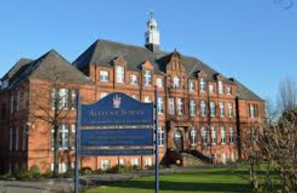
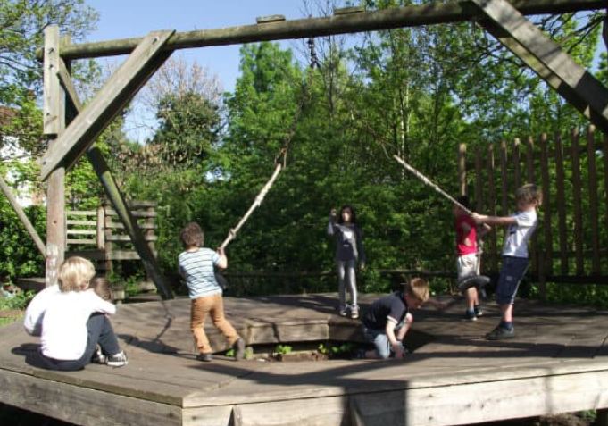
Local Partnerships
Alleyn's Secondary School
Throughout the year we offer many opportunities to work alongside Alleyn's School.
Reading sessions
Spanish Sessions
Computing Sessions
Music Sessions
The Big Read
Sports Day
DKH Adventure Playground
We would like to encourage you to visit DKH Adventure Playground! We will be organising some trips for each class and their parents to attend. It is a fantastic place for your children to explore the environment and they regularly organise Music and Art sessions each week!

Slide 22

New Parents, Teachers Association Recruits!
We are looking for some new recruits to our PTA! If you would love to sign yourself up to support in organising and running events for our children here at our School, please let your class teacher, a member of the Senior Leadership Team or the Office know!

Slide 23
Monday | Tuesday | Wednesday | Thursday | Friday
Year 6 Brass 2:30-3:15 |  | Dance year 6 Homework due Reading records due |  | PE

Slide 24
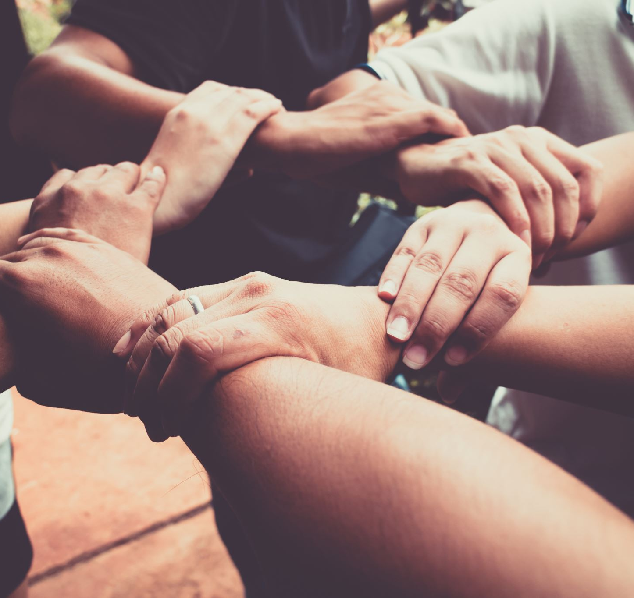
Thank you!
We look forward to another very successful year together!
We continue to be committed to provide you with clear communications and expectations but there may be times when we have to make changes and ask for your continued support.

